Slide 1
Area of Disinfection
Water Tanks; Cooling towers; Aircon
Disinfectant
H²O²
Target
Legionela
Ecoli
ISO
Task
Development of PCR/ dPCR
Development of LAMP
Sample Preparation
From water and from air
Live bacteria
TPCs a method of estimating the total number of microorganisms (mold, yeast, bacteria) in a material
Detect other bacteria present

Slide 2
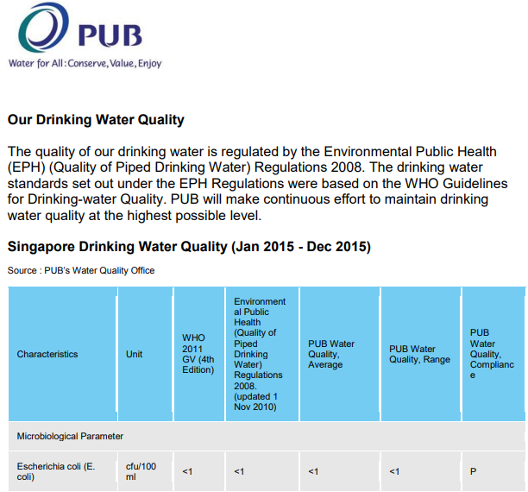
Singapore PUB Water Quality: E.coli Monitoring standards
Drinking water standards set out under EPH regulations were based on WHO guidelines for drinking-water Quality
E. Coli detection = <1 of Cfu per100ml

Slide 3


Regulations for Cooling towers and water fountains in use
Environmental Public Health (Cooling Towers And Water Fountains) Regulations 2001
a standard plate count that does not exceed 100,000 colony-forming units per milliliter
a legionella bacteria count that does not exceed 10 colony-forming units per milliliter
Drift (“Water Aerosol”) Eliminators
A cooling tower installed which is in use should be sampled and tested by a Government laboratory or any other laboratory approved by the Commissioner —
at least once a month for the purpose of determining the standard plate count; and
at least once every 3 months for the purpose of detecting legionella bacteria.
Legionella bacteria count = <10 Cfu per 1ml
Notes:
CFU – Colony-forming unit → It estimates the number of bacteria or fungal cells in a sample which are viable, able to multiply via binary fission under the controlled conditions
https://www.nea.gov.sg/docs/default-source/our-services/environmental-public-health-(cooling-towers-and-water-fountains)-regulations-(180-kb).pdf

Slide 4
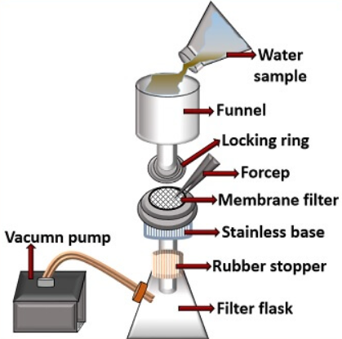
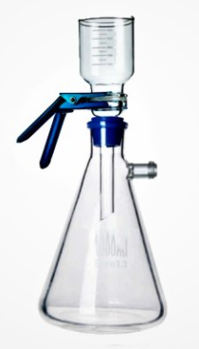
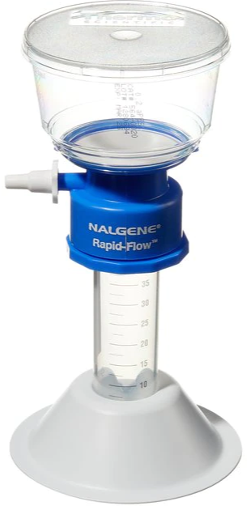
Water sample: Conventional method of detection
Water sampling
Aerosol sampling
a)
b)
Filtration is one of the most commonly used methods
to capture airborne particles, including bioaerosols,
because it is convenient and easy to use. Once the
bioaerosol particles are collected on a filter, they can
be eluted into liquid for subsequent analysis by various
techniques.
Polycarbonate, mixed cellulose ester, polytetrafluoroethylene
(Teflon, PTFE), polyvinyl chloride (PVC), nylon, gelatin, and other filter types have been used for bioaerosol sampling depending on the selected analysis technique
Membrane filtration method:
Water sample collected ~100ml
Size ≤0.22µm
Place membrane in between locking ring (a)
Supported with vacuum pump
Membrane filter extracted for culture in petri dish
Preparation of appropriate (specific) media
Culture growth of 24-48 hours
Visual detection

Slide 5
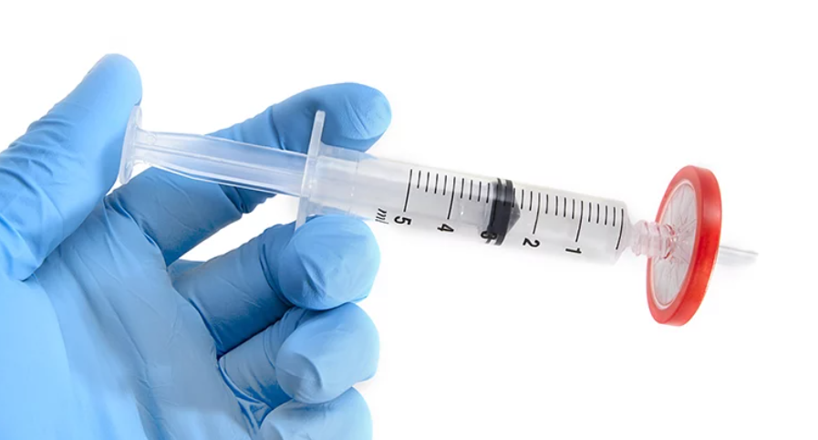
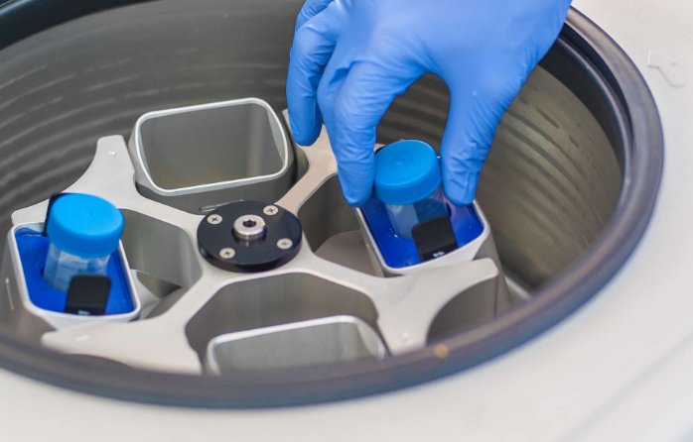

Water sample
Swabs specimen
Aerosol specimen
Membrane filtration method:
Size ≤0.22µm
Syringe-filter to trap bacteria (size)
Filter through ~500uL of lysis buffer slowly
Solution heated for 5 mins at 98degC
PCR/ LAMP test
Simple Centrifugation method:
Centrifuge 50ml Falcon tube ~4000 to 6000 rpm
Remove as much supernatant, not to touch the tip
Add lysis buffer
Solution heated for 5 mins at 98degC
PCR/ LAMP test
Multiple swab in lysis buffer(tube)
Incubate swabs in lysis buffer
Remove swabs
Solution heated for 5 mins at 98degC
PCR/ LAMP test
Collect aerosol specimen using Vacuum-membrane filtration unit
Switch on vacuum pump for 30mins for collection of particle onto membrane filter
Remove and roll the membrane filter with the surface facing inwards
Add lysis buffer
Solution heated for 5 mins at 98degC
PCR/ LAMP test

Slide 6
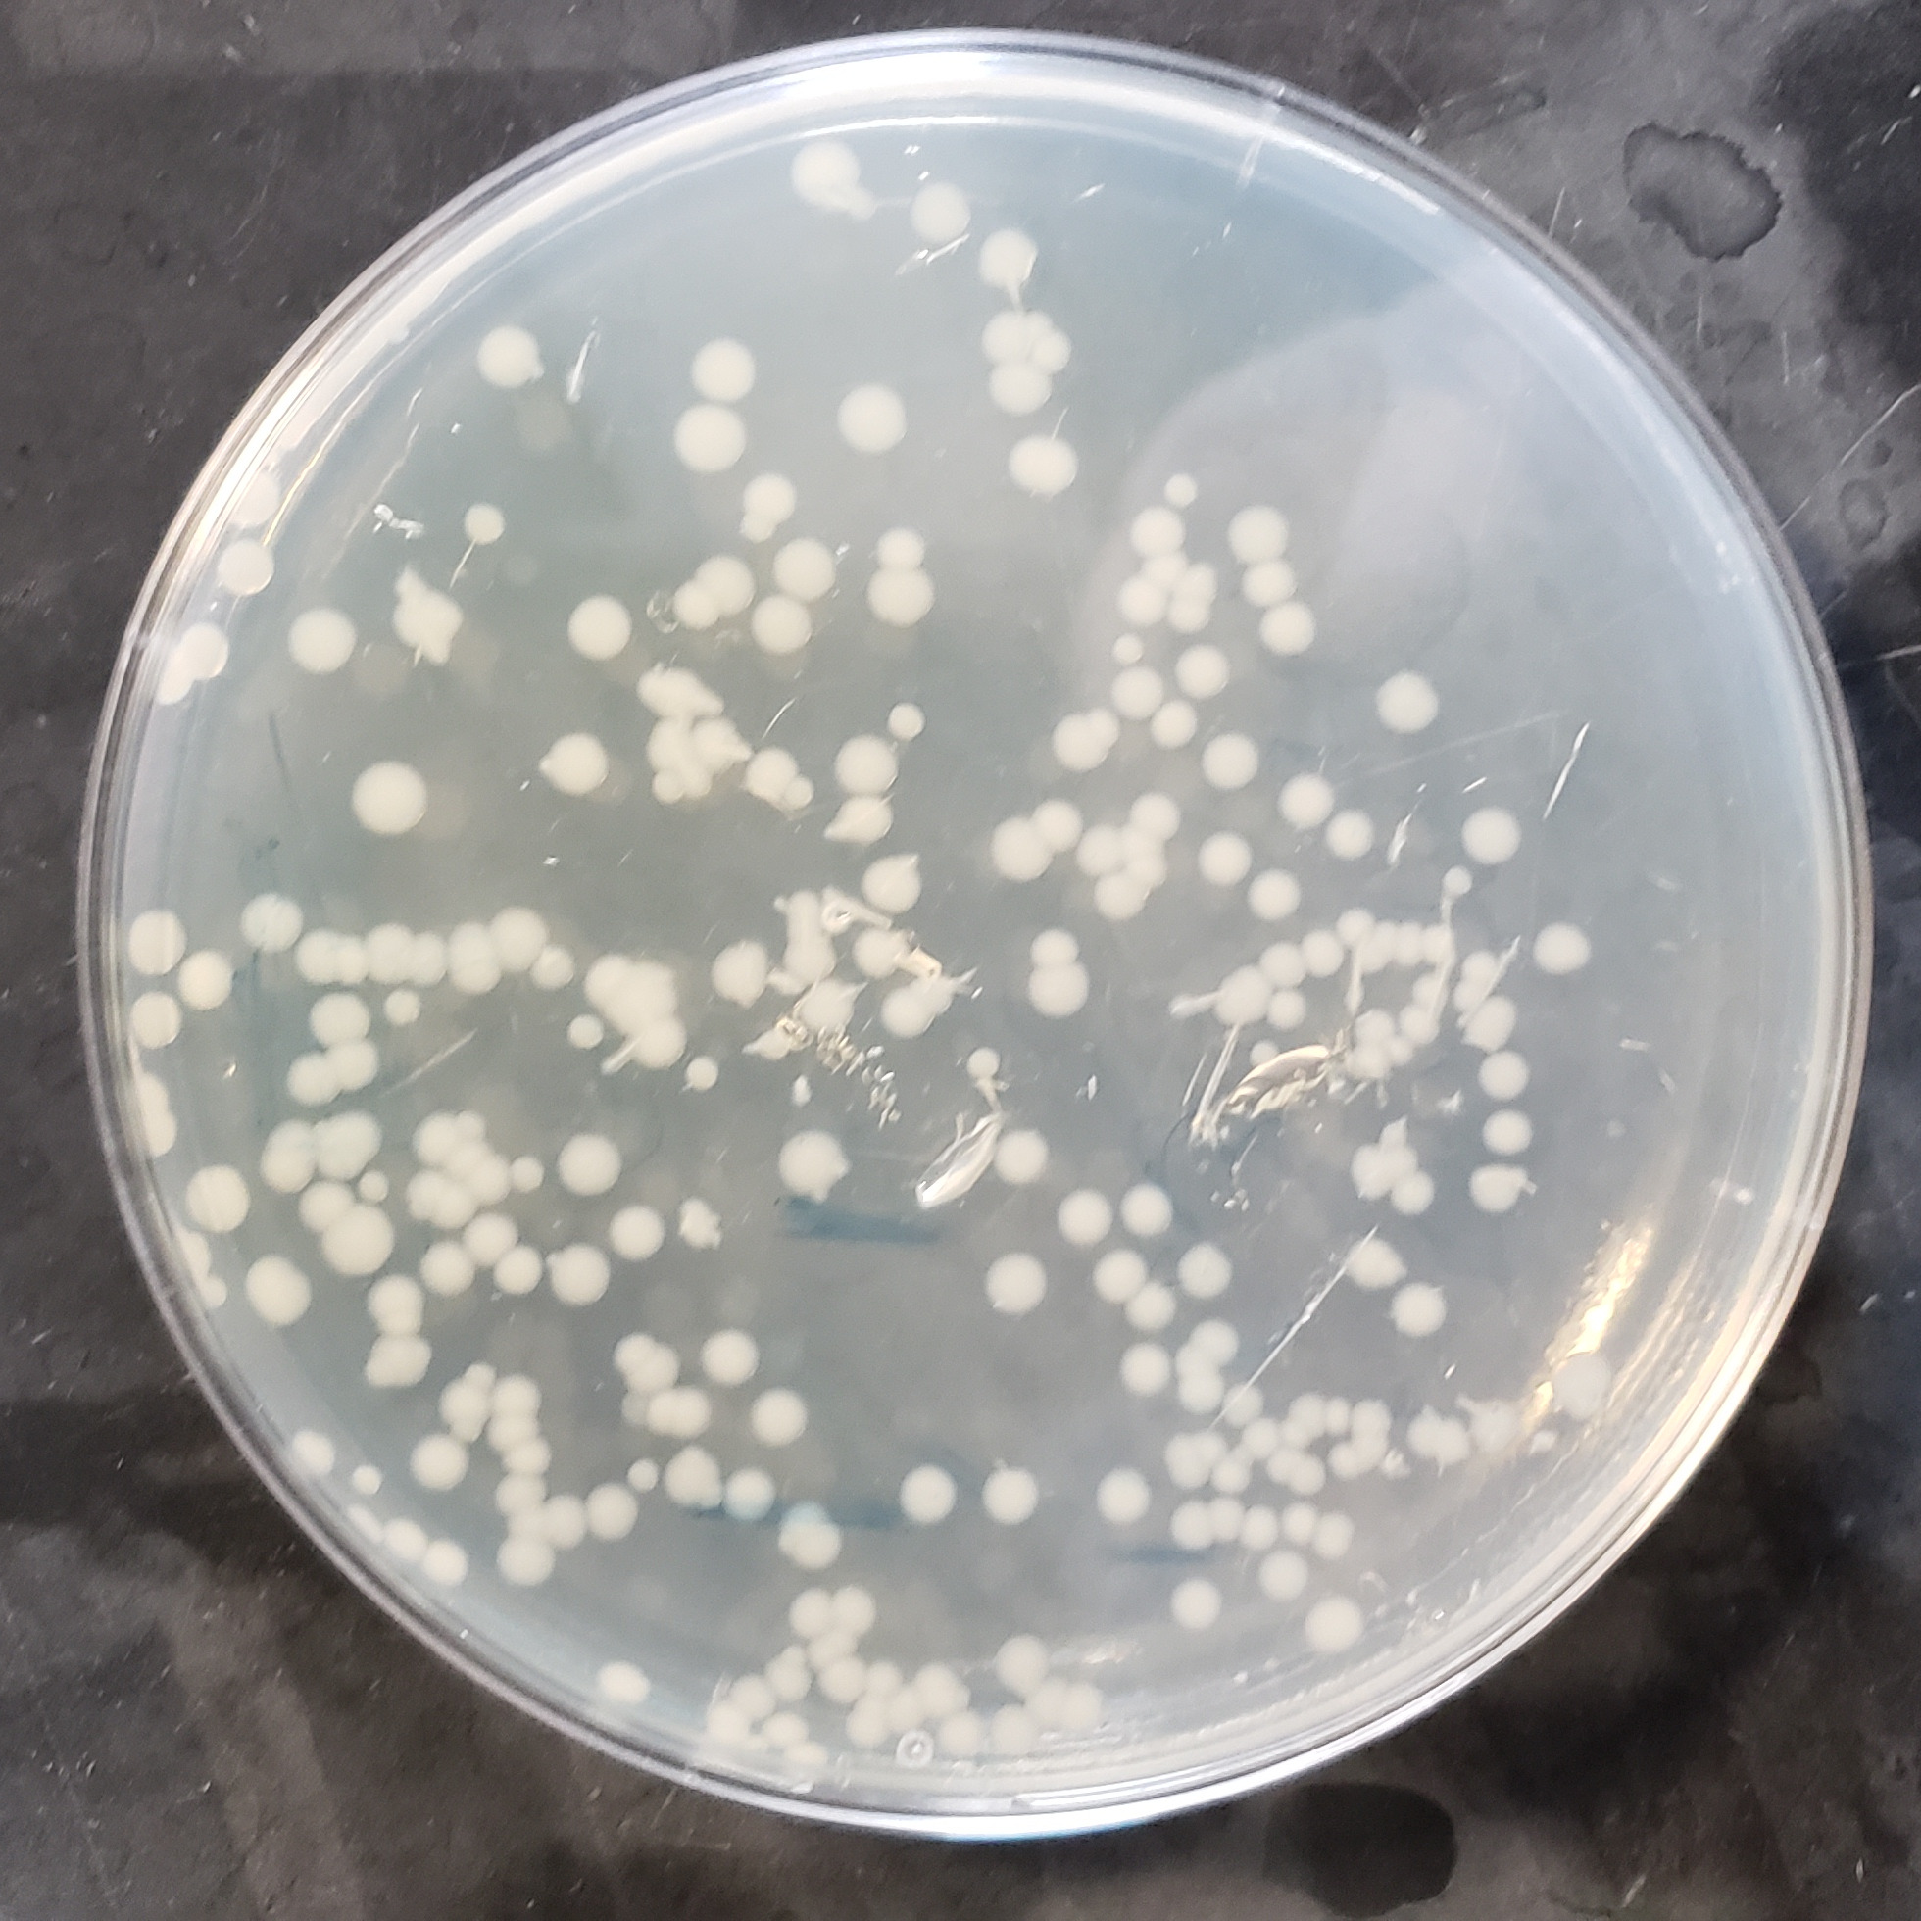
Extraction Plan for E. Coli
Notes:
Option 1:
Remove bacteria from culture plate with an inoculation loop and suspend in 180 μl of Buffer ATL (supplied in the QIAamp DNA Mini Kit) by vigorous stirring
Option 2:
Pipet 1 ml of bacterial culture into a 1.5 ml microcentrifuge tube, and centrifuge for 5 min at 5000 xG (7500 rpm).
Calculate the volume of the pellet or concentrate and add Buffer ATL (supplied in the QIAamp DNA Mini Kit) to a total volume of 180 μl. After wich both follows Protocol: DNA Purification from Tissues“ from step 3.

Slide 7
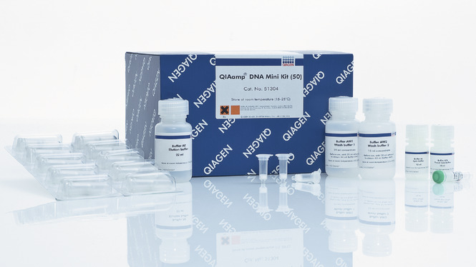
Extraction Plan for E. Coli
QIAamp DNA Mini Kit
Option 1: Isolation of genomic DNA from bacterial plate cultures
Option 2: Isolation of genomic DNA from bacterial suspension culture
Notes:
Option 1:
Remove bacteria from culture plate with an inoculation loop and suspend in 180 μl of Buffer ATL (supplied in the QIAamp DNA Mini Kit) by vigorous stirring
Option 2:
Pipet 1 ml of bacterial culture into a 1.5 ml microcentrifuge tube, and centrifuge for 5 min at 5000 xG (7500 rpm).
Calculate the volume of the pellet or concentrate and add Buffer ATL (supplied in the QIAamp DNA Mini Kit) to a total volume of 180 μl. After wich both follows Protocol: DNA Purification from Tissues“ from step 3.

Slide 8
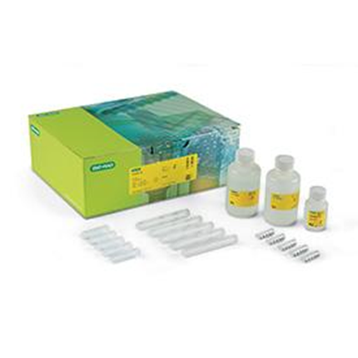
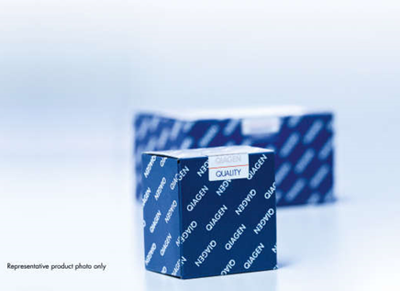
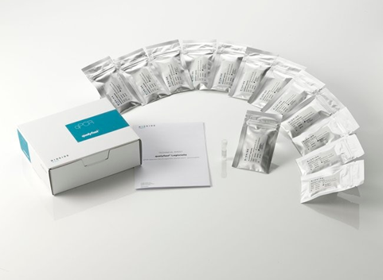
Commercially Available Extraction Kits
Bio Rad - Aquadien™ Bacterial DNA Extraction and Purification Kit
Applicable for both Legionella
& E. Coli Extraction
Suitable for: Bacterial DNA extraction from water samples, Aerosols & Biofilms
QIAGEN- DNeasy PowerWater Kit
Applicable for both Legionella
& E. Coli Extraction
Suitable for: Bacterial DNA extraction from water samples only
Thermo Scientific - qualyfast ® DNA Extraction kit I / II
Applicable for both Legionella
& E. Coli Extraction
Suitable for: Bacterial DNA extraction from Clear/dirty water samples and sediments
Notes:
https://www.bio-rad.com/en-sg/sku/3578121-aquadien-bacterial-dna-extraction-purification-kit?ID=3578121
https://www.qiagen.com/us/products/discovery-and-translational-research/dna-rna-purification/dna-purification/microbial-dna/dneasy-powerwater-kit/
https://www.thermofisher.com/order/catalog/product/D211001

