Slide 1
Water quality monitoring for
Legionella pneumophila and Escherichia coli

Slide 2
Progress update
1. Membrane Filtration: Syringe Filter with 10mL spiked with Live and “Dead” sample
Pore size: 0.22 µm vs 0.45 µm
“Dead” Sample was heated at 95deg for 10mins
ES lysis buffer volume: 1000 µL
2. Testing Potential elution buffers
A. AE, ce8, ce8.4 and ZE
E lysis buffer volume: 500 µl
No Syringe Filter
B. ZE Buffer
E lysis buffer volume: 500 µl
No Syringe filter & column involved
3. Membrane Filtration: Syringe filter with spiked samples into 10 mL of Clean Tap water, Tap water, LB Broth & MilliQ Water (10mL & 500 mL)
Pore size: 0.22 µm vs 0.45 µm
ES lysis buffer volume: 1000 µL

Slide 3
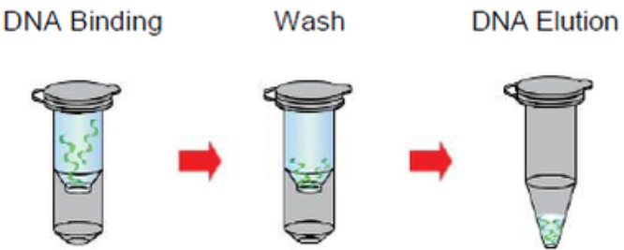
Membrane Filtration: Syringe Filter with 10mL spiked with Live and “Dead” sample
(
LIVE 100ul of culture was aliquoted
DEAD 100ul of culture was heated at 95degC for 10mins
1. Spiked in E. coli in 10mLMiliQ water
2. Filter water sample through syringe filter
3. Reverse lysis buffer through the same filter
4. Heat 80degC for 10 minutes
QIAamp DNA mini kit consumables
1
2
3
4
Either
0.2 µm or 0.45 µm
1000 µL
5
Heating After
To Lyse

Slide 4
Membrane Filtration: Syringe Filter with 10mL spiked with Live and “Dead” sample
Notes:
20220518R2

Slide 5
Testing Potential elution buffers - AE, ce8, ce8.4 and ZE
A
1. Aliquote 100ul of culture
2. Add 500ul of ES Lysis buffer
3. Heat at 80degC for 10 minutes
QIAamp DNA mini kit consumables
Elution with
Qiagen’s AE Buffer
Ce8
Ce8.4
ZE
1
2
3
4
To test if any of the elution buffers is comparable to Qiagen’s Elution Buffer
B
1. Aliquote 100ul of culture
2. Add 500ul of ES Lysis buffer
3. Heat at 80degC for 10 minutes
4. Centrifuge for 16,060g for 10mins
5. Remove supernatant and add 100ul of Elution buffer
1
2
3
4
5
Elution with
Qiagen’s AE Buffer
Variations of ZE Buffer
To test if it is possible to eliminate the spin column from the workflow

Slide 6
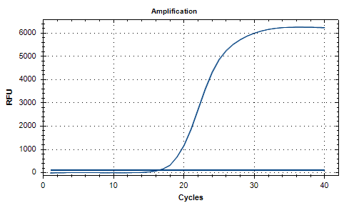
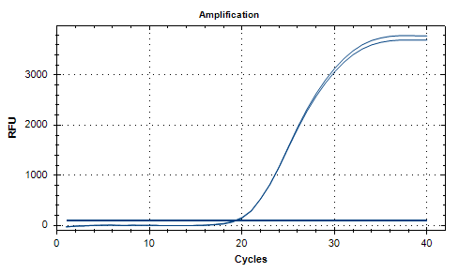


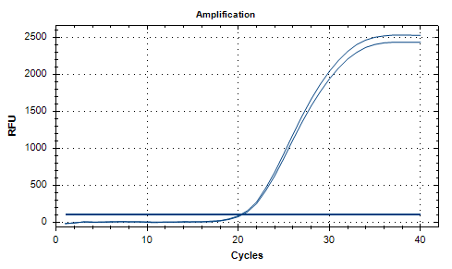
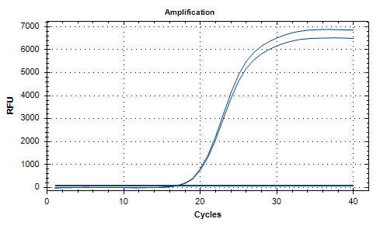


Testing Potential elution buffers - AE, ce8, ce8.4 and ZE With Spin column
A
Qiagen’s AE elution Buffer
Ce8 elution Buffer
Ce8.4 elution Buffer
ZE elution Buffer
ZE Elution buffer is ~1 CT different from the Qiagen’s elution buffer

Slide 7
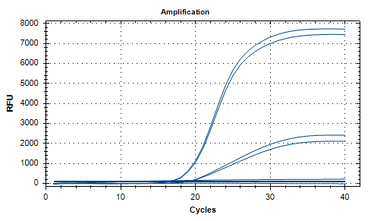
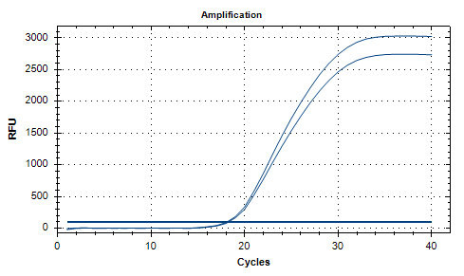


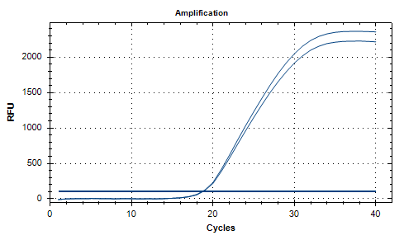
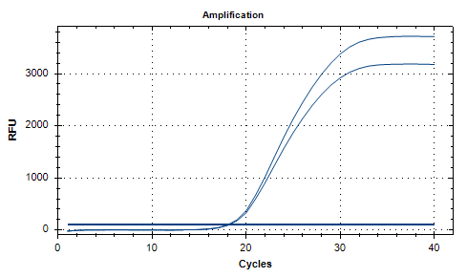


Testing Potential elution buffers – AE, ZE, ZE2, ZE3 Without Spin Column
B
Qiagen’s AE elution Buffer
ZE elution Buffer
With spin Column
Without spin
Column
ZE2 elution Buffer
ZE3 elution Buffer
The variations of the ZE buffer work slightly better than Qiagen’s AE buffer without spin column but not as well as with a column.

Slide 8
Membrane Filtration: Syringe filter with spiked samples into 10 mL of Clean Tap water, Tap water, LB Broth & MilliQ Water (10mL & 500 mL)
1. Spiked in E. coli in different mediums
2. Filter water sample through syringe filter
3. Reverse lysis buffer through the same filter
4. Heat 80degC for 10 minutes
QIAamp DNA mini kit consumables
1
2
3
4
Either
0.2 µm or 0.45 µm
1000 µL Elution Buffer
Mediums
- Tap water (10ml) - LB Broth (10ml)
- MilliQ Water
(10ml & 500ml)
5
To determine if the different medium accounts for the losses during extraction
To determine if the volume of medium (MilliQ) accounts for the losses during extraction

Slide 9
Membrane Filtration: Syringe filter with spiked samples into 10 mL of Clean Tap water, Tap water, LB Broth & MilliQ Water (10mL & 500 mL)
Comparing 10ml & 500ml MilliQ Water used, the difference in ct (ct: 0.38 & 0.44) shows that there are is small amount of loss during extraction
LB Broth and MilliQ has about 1 Ct Difference
0.4um membrane is able to capture more bacteria
→ 0.4um
Based off the difference in ct, the different mediums only slightly affects the amount of bacteria captured.

Slide 10
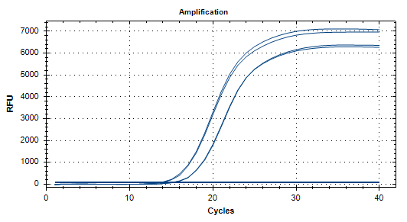

Membrane Filtration: Syringe filter with spiked samples into 10 mL of Clean Tap water, Tap water, LB Broth & MilliQ Water (10mL & 500 mL)
QiaAmp
Direct Extract w/ ES Lysis
The variations of the ZE buffer work slightly better than Qiagen’s AE buffer without spin column but not as well as with a column.

