Slide 1
Water quality monitoring for
Legionella pneumophila and Escherichia coli

Slide 2
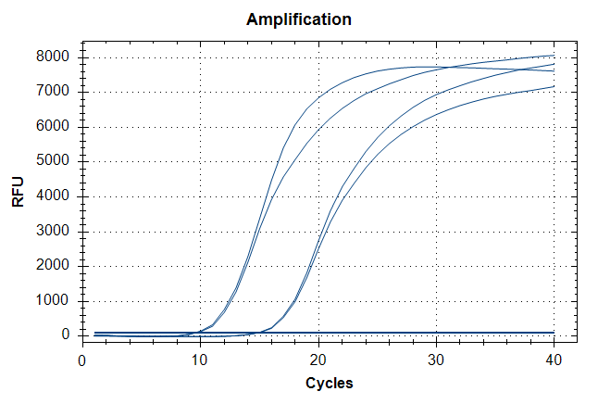
Advantages of Prepared buffer protocol:
1. Flexible in modification of lysis buffer for optimization
2. Shorter duration of extraction from bacterial cells (10 mins instead of 75 mins)
3. 100 µL of sample (No need to centrifuge for pellet) can be processed directly.
4. Currently, 1 heating temperature (80 degC) as compared to reference protocol (56 & 70 degC).
Disadvantages of Prepared buffer protocol:
1. May be inefficient in extracting cell pellet with E Lysis buffer; ~50% (nanodrop)
qPCR difference
QIAamp
E Lysis
buffer
EC pellet
Subsequent Plans:
Optimization of Prepared Lysis buffer
1. Temperature: RT vs 70degC (10mins) vs 80 degC (10mins) vs 90 degC (10mins)
2. Modification (Addition of detergent etc.)
Direct Sample extraction vs Filtered Sample Extraction;
1. Syringe membrane filter (0.2um) may be used to trap Bacterial cells (I.e. E. coli) from water sample (Spiked-in samples).
2. Lysis of cells within the membrane filter using modified buffer.
3. Determine % of yield loss.

Slide 3
Progress update
Membrane Filtration: Syringe filter with 10 mL spiked in sample
Pore size: 0.22 µm vs 0.45 µm
E lysis buffer volume: 455 µL vs 1000 µL
2. Membrane Filtration: Membrane filtration unit (Vacuum assisted) with 500 mL Spiked in Sample
Pore size: 0.22 µm
E lysis buffer volume: 5mL
Membrane removal by scalpel knife
Lysis step: Pulse-Vortex contact lysis vs Soaked filter in lysis buffer
3. Different sample preparation with E lysis and E+SDS lysis for syringe filtration

Slide 4
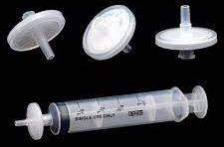
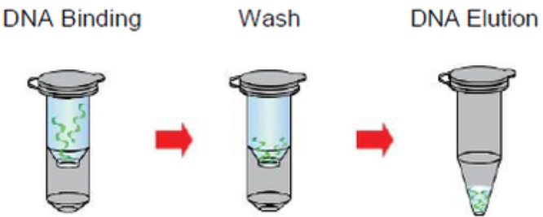
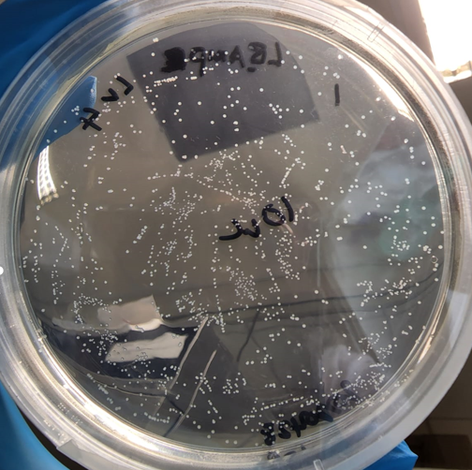
Membrane Filtration: Syringe filter (SF) with 10 mL spiked in sample
100µL of sample is eluted out
QIAamp DNA mini kit consumables
1. Spiked in E. coli in 10mL MiliQ water
2. Filter water sample through syringe filter
3. Filter E lysis buffer through the same filter
1
2
3
0.2 µm
455 µL
4
1. Grow . coli on Agar Plate
Bacterial Cell Counting
qPCR detection
1
To establish filtration workflow using 0.2 SF and determine yield loss in extraction
To get a sense of bacterial count relative to qPCR ct value

Slide 5
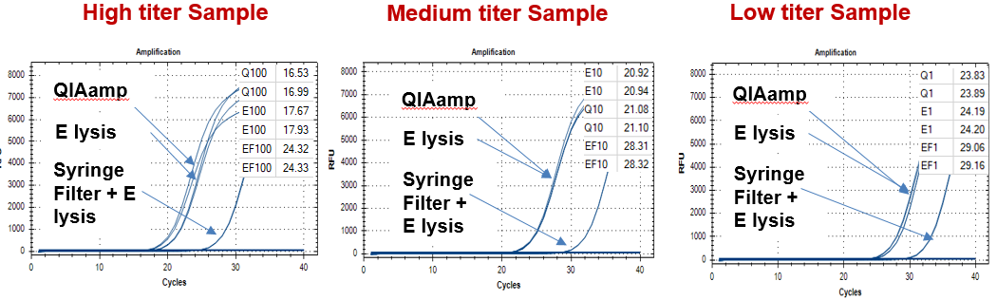
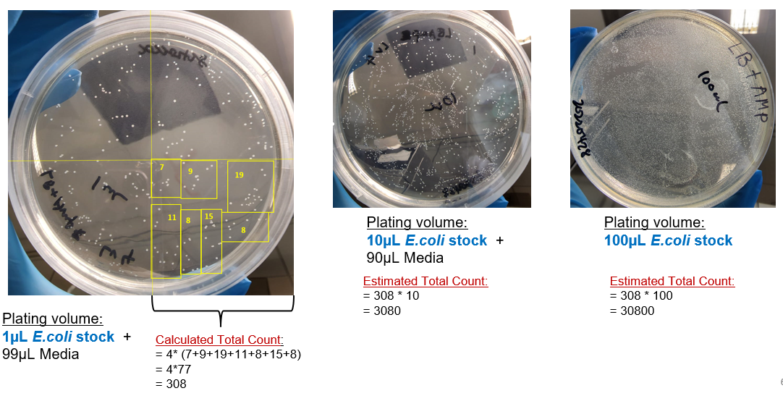
Membrane Filtration: Syringe filter (0.2µm) with 10 mL water sample
0.2µm Syringe filter (SF) was able to capture E. coli from 10mL of spiked in sample
A greater delay was observed in medium and high titer of sample load as compared to low titer.
Notes:
20220429 Run 1

Slide 6
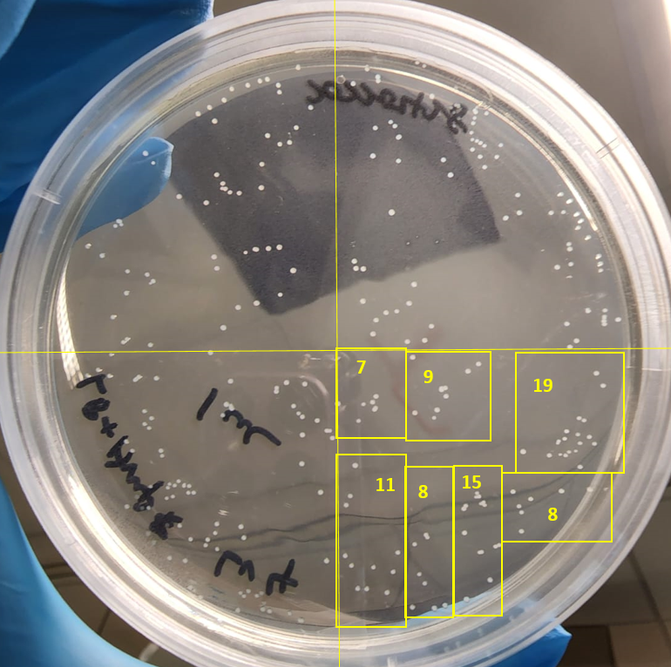
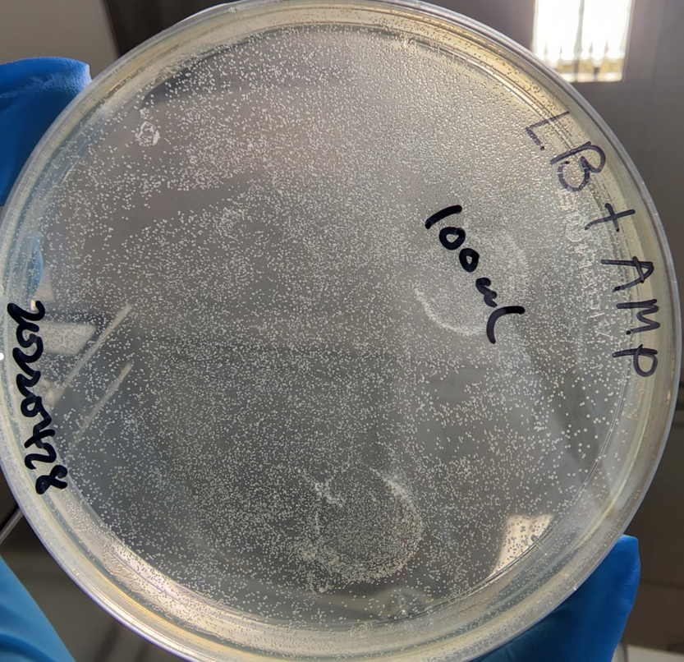
Membrane Filtration: Syringe filter with 10 mL spiked in sample
Bacterial Counting: 1 µL, 10 µL, 100 µL volume of E .coli stock
Plating volume:
10µL E.coli stock + 90µL Media
Plating volume:
100µL E.coli stock
Estimated Total Count:
= 308 * 10
= 3080
Estimated Total Count:
= 308 * 100
= 30800
Plating volume:
1µL E.coli stock + 99µL Media
Calculated Total Count:
= 4* (7+9+19+11+8+15+8)
= 4*77
= 308
Notes:
20220429 Run 1

Slide 7
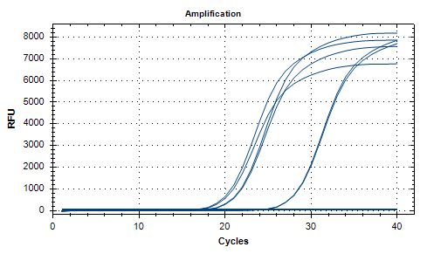
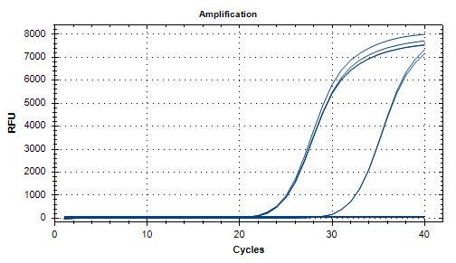
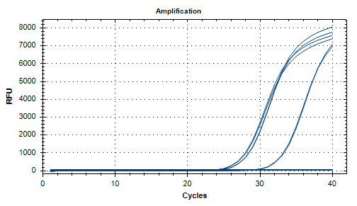



Membrane Filtration: Syringe filter with 10 mL spiked in sample
Comparison Between direct E lysis and 0.2µm syringe Filter
High titer Sample
Medium titer Sample
Low titer Sample
QIAamp
QIAamp
QIAamp
E lysis
E lysis
E lysis
Syringe Filter + E lysis
Syringe Filter + E lysis
Syringe Filter + E lysis
Differences between direct E lysis & syringe filter: ~7 ct
Differences between direct E lysis & syringe filter: ~7 ct
Differences between direct E lysis & syringe filter: ~5 ct
Threshold : 100
Notes:
20220429 Run 1

Slide 8
Membrane Filtration: Syringe filter with 10 mL spiked in sample
(0.2µm & 0.45µm)
100µL of sample is eluted out
QIAamp DNA mini kit consumables
1. Spiked in E. coli in 10mLMiliQ water
2. Filter water sample through syringe filter
3. Filter E lysis buffer through the same filter
1
2
3
Either
0.2 µm or 0.45 µm
Either
455 µL or 1000 µL
4
1. Grow E. coli on Agar Plate
Bacterial Cell Counting
qPCR detection
1
To compare filtration workflow using 0.2 & 0.4um SF and determine yield loss in extraction
To assess the performance of using different volume of E lysis buffer
To get a sense of bacterial count relative to qPCR ct value

Slide 9
Membrane Filtration: Syringe filter(SF) (0.2µm & 0.4µm) with 10 mL water sample
An increased volume of lysis buffer shows improvement in overall extraction yield of 0.4 SF and not 0.2 SF
The use of 0.4 SF shows better performance in extracting low titer load of sample
A greater delay was observed in medium and high titer of sample load as compared to low titer.
Notes:
20220429 Run 1

Slide 10
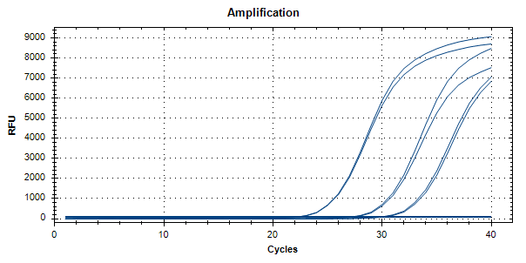
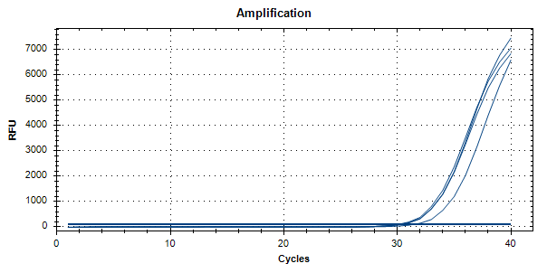
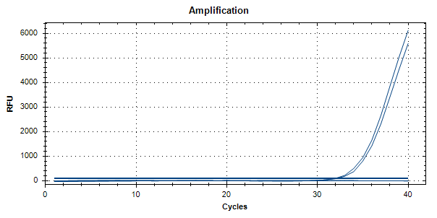
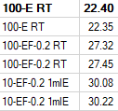


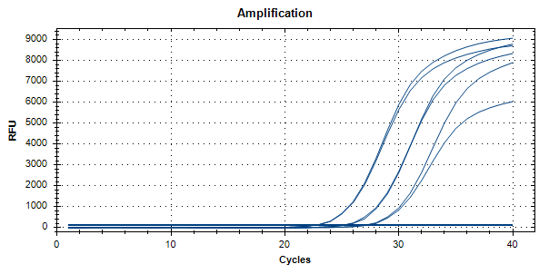
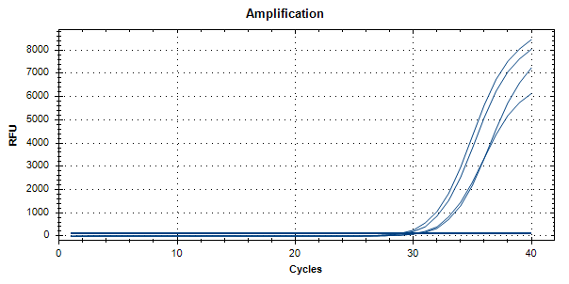
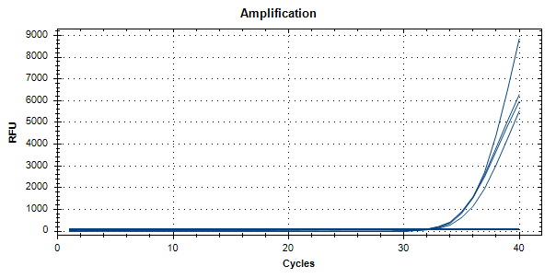
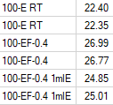


Membrane Filtration: Syringe filter with 10 mL spiked in sample
Comparison Between 0.2µm & 0.45µm Syringe Filter
Note: Using 0.4um Filter flushed with 1ml of lysis buffer gave the best results but further optimization should be carried out.
Threshold : 100
Notes:
20ul of culture was spiked into 4ml of culture. = 100ul culture. To compare dna yield extracted, the volume of lysis tested was 455ul and 1ml. Conclusion: Using 0.4um Filter flushed with 1ml of lysis buffer gave the best results. Further optimization can be carried out by increasing the contact time of the lysis buffer with the membrane. (Use a larger volume of lysis buffer or let the lysis buffer stay on the membrane for a certain time before flushing out)

Slide 11
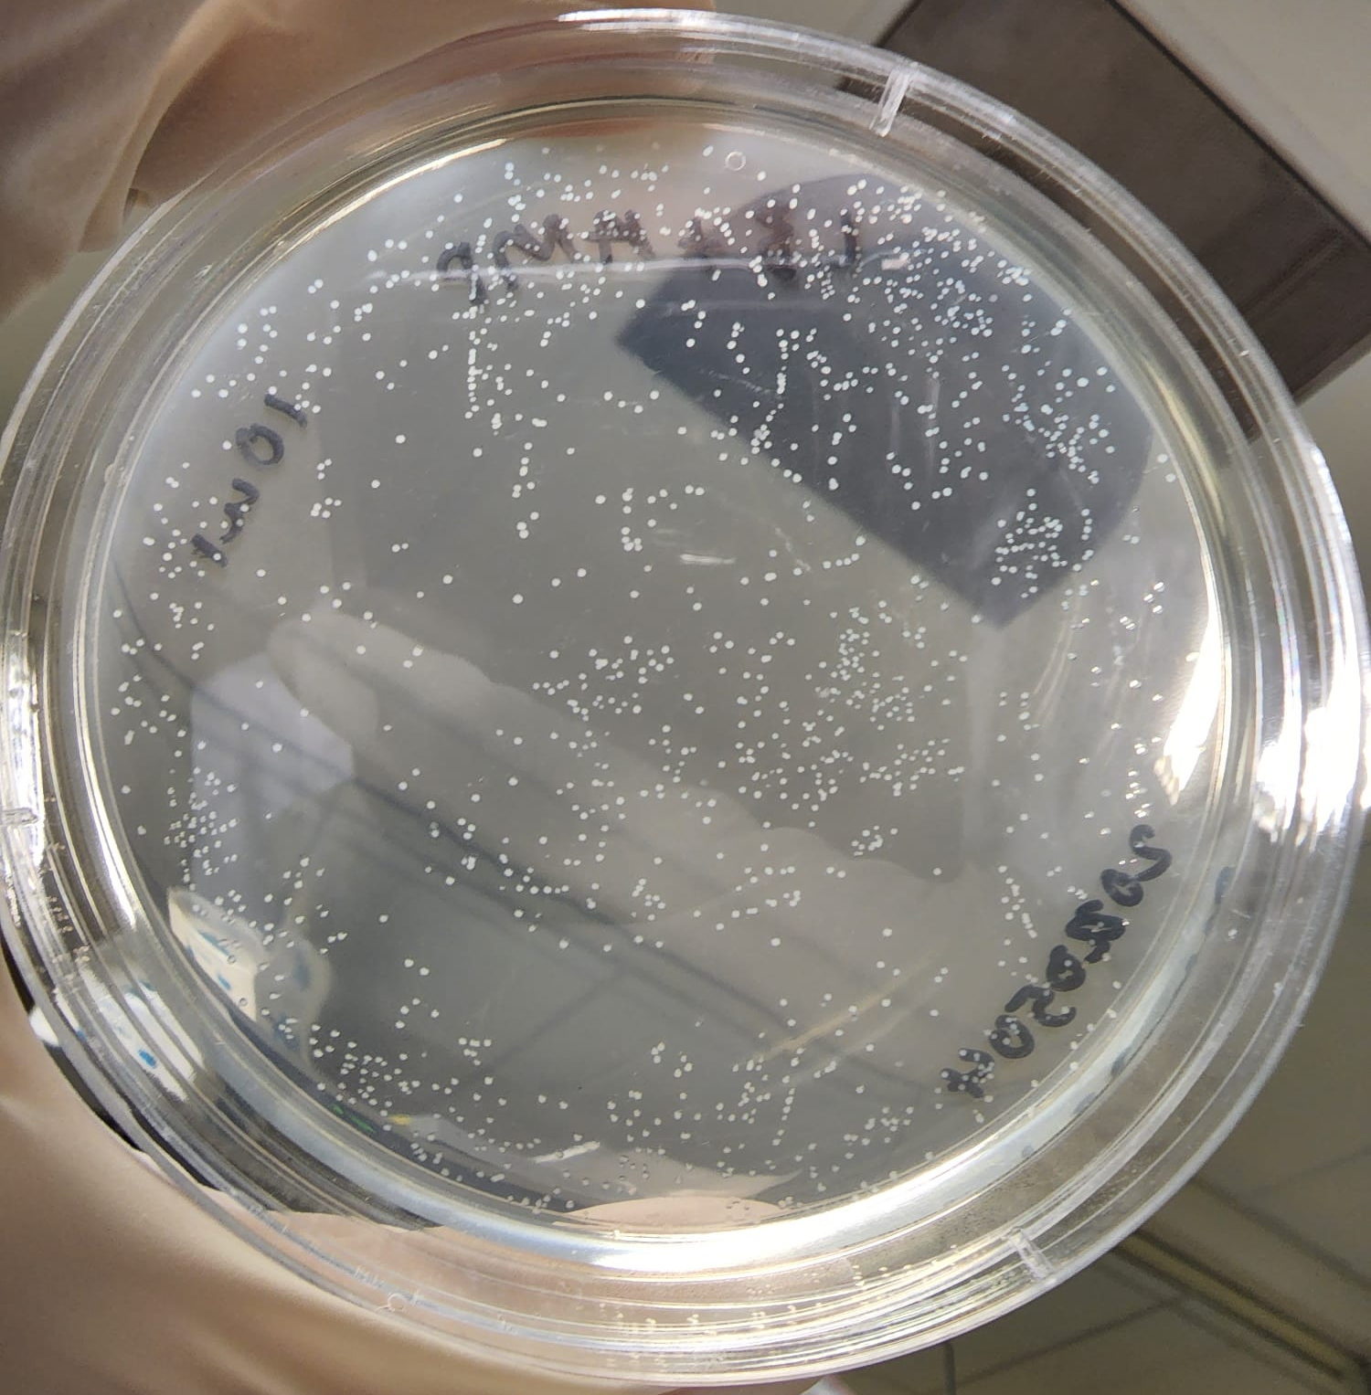
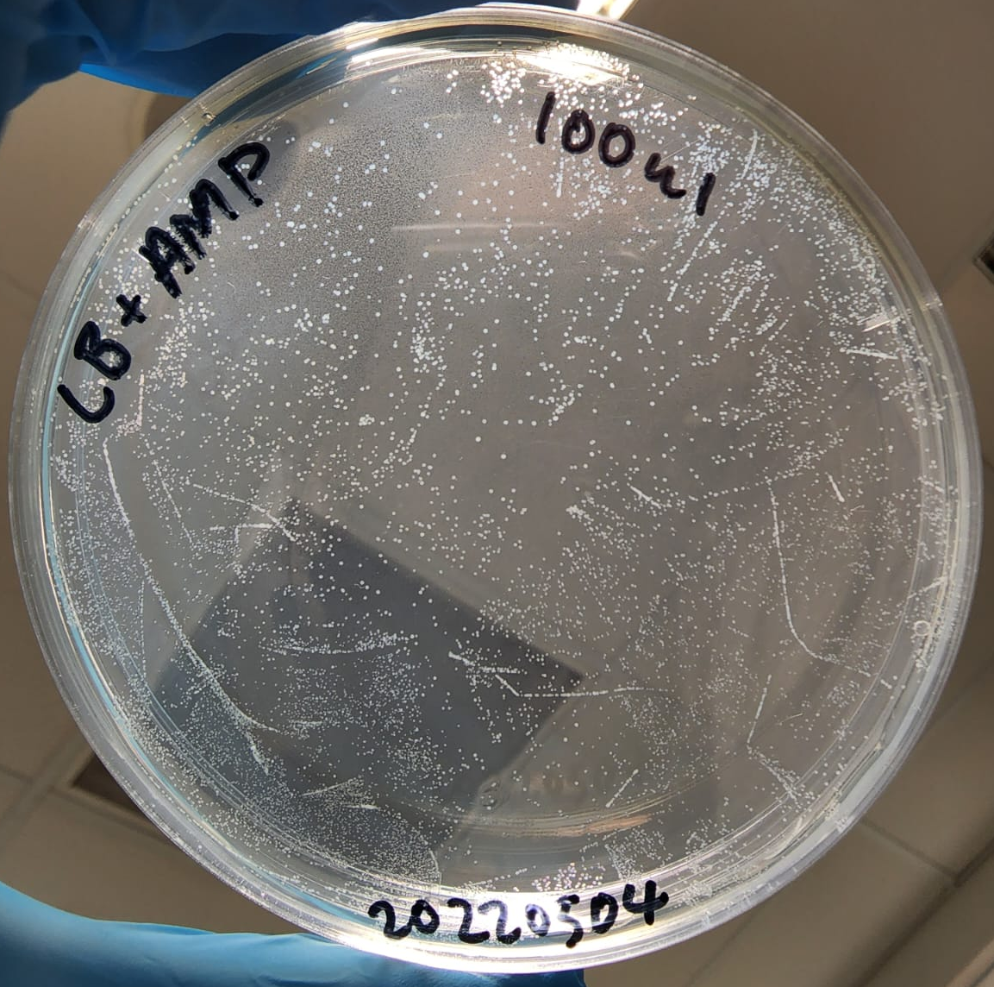
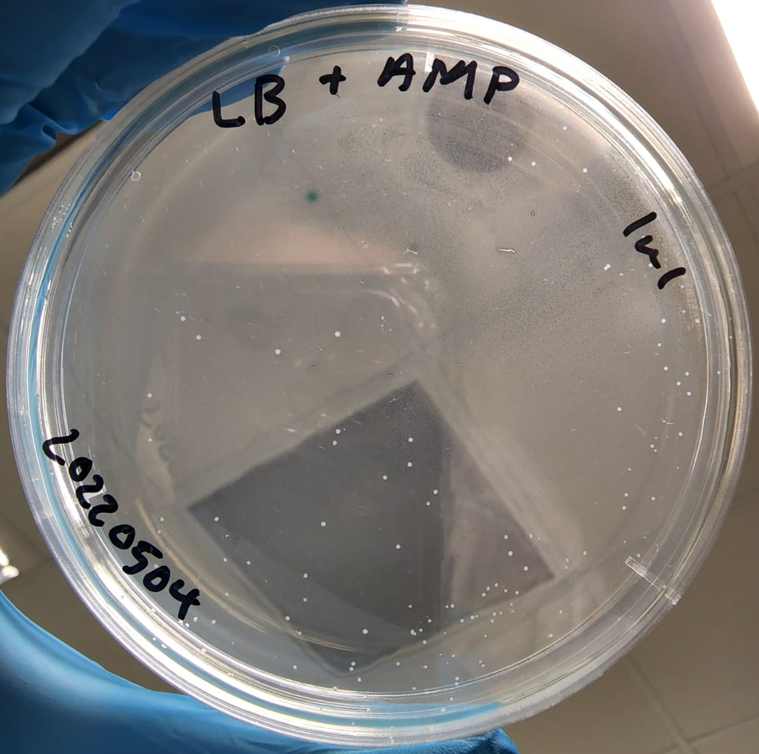
Bacterial Counting: 1 µL, 10 µL, 100 µL volume of E .coli stock
63
49
47
30
54
36
31
Plating volume:
100µL E.coli stock
Plating volume:
1µL E.coli stock + 99µL Media
Plating volume:
10µL E.coli stock + 90µL Media
Estimated Total Count:
= 125 * 100
= 12500
Calculated Total Count:
= 125
Calculated Total Count:
= 4* (63+49+47+54+30+31+36)
= 4*310
= 1240

Slide 12
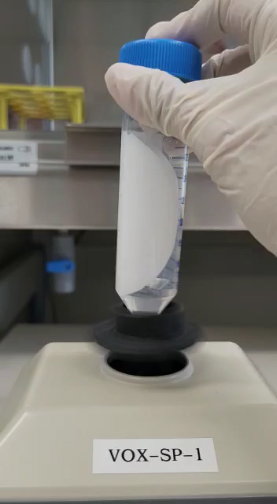
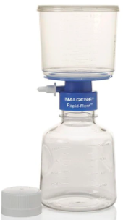
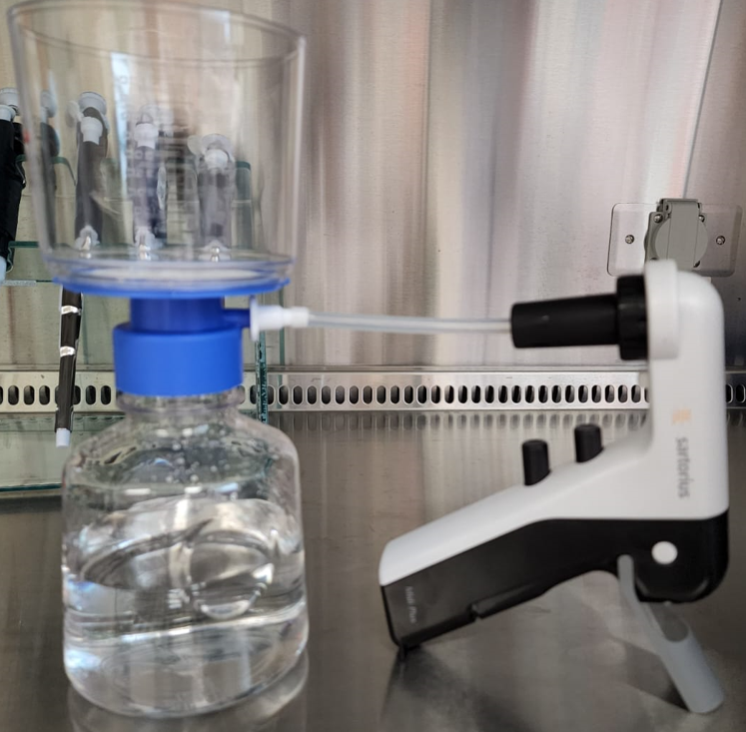

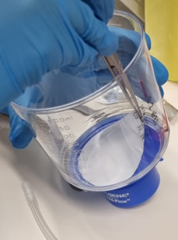
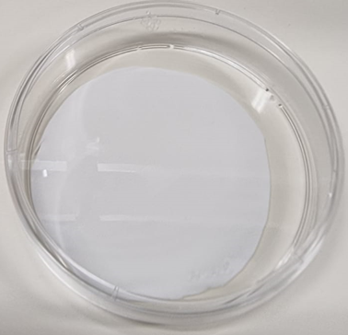

2. Membrane Filtration: Membrane Filtration Unit (FU)(0.2µm) (Vacuum assisted)
1. Add 500 mL into filtration unit
2. Spike in E. coli sample
3. Vacuum assisted filtration
4. Membrane filter removal by scalpel knife
5.1 Membrane filter inserted in 50mL falcon tube;
5 mL of E lysis buffer; 3 mins; pulse-Vortex
1
2
3
4
5
5
5.2 Membrane filter soaked in 5 mL of E lysis buffer; 3 mins; shaking
6
To establish filtration workflow using 0.2µm FU and determine yield loss in extraction
QIAamp DNA mini kit consumables
100$µL$ of sample is eluted out
Notes:
Conclusion: Heating the lysis buffer before flushing did not make significant differences to the amount of E. coli captured.

Slide 13
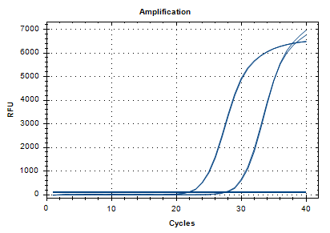
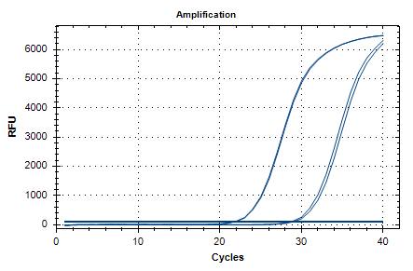


E lysis buffer Membrane Filtration Unit (FU)(0.2µm)
Threshold : 100
5.26 ct delayed
6.6 ct delayed
Control
Control
Vortex
Petri dish
Vortex:
Membrane filtration; contact lysis by pulse-vortexing
Petri dish:
Membrane filtration; contact lysis by soaking in lysis buffer-filled petri dish
For filtration unit, Vortex-lysis improved extraction performance
Notes:
20220509

Slide 14
3. Membrane Filtration: Syringe filter (SF) with different lysis buffer
100ul of sample is eluted out
3. Filter E & ES (inclusive of SDS) lysis buffer through the same filter
QIAamp DNA mini kit consumables
4
1. Spiked in E. coli in 10ml MiliQ water
2. Filter water sample through syringe filter
1
2
3
Either
0.2 µm or 0.45 µm
Either
1000 & 5000 µL
3
3. Bi-directional & Reverse extraction of E. coli cells with E lysis buffer through the same filter (0.4um)
qPCR detection
To compare extraction performance using 0.2 & 0.4um SF with the addition of SDS in lysis buffer and the usage of different volume of lysis buffer
To try different method of sample lysis and collection method using SF

Slide 15
3. Membrane Filtration: Syringe Filter (SF) (0.2µm vs 0.45µm)
E lysis buffer
ES lysis buffer (+SDS)
ES lysis buffer improved DNA extraction than E lysis buffer
Reverse lysis and collection method reduces yield loss

Slide 16
Remarks
Both Filtration Unit and syringe filter shows a delay of ~5ct from Direct E lysis
0.45um syringe with a 1mL elution shows a lesser yield delay of ~3ct (maybe 0.2um yield is lesser due to the entrapment of DNA-others complex inside membrane)
Cellular debris (Proteins, lipids and saccharides etc.) may clog membranes and interfere with downstream applications.
Qns
E.coli settled at the side/ corner of the filtration unit funnel/ Syringe
E. coli cells trapped in filter membrane (incomplete lysis)
E. coli gDNA trapped in filter membrane (lysed but unable to flush them out with lysis buffer)
Column step: AE elution buffer unable to fully elute the trapped DNA due to its compatibility with E lysis (Mainly NaOH)
Try
Collect the liquid from the side/ corner & do a direct extraction/ agar growth
Increase E lysis buffer used (Syringe:1ml & 5ml; filtration unit 5mL & 10mL vortex)
Change Composition of filter membrane?
Include SDS in lysis buffer to denature protein and impose –ve charge to proteins and prevent accumulation
Try other detergent composition (Triton X)
Column step: AE elution buffer unable to fully elute the trapped DNA due to its compatibility with E lysis (Mainly NaOH)
QIAamp uses silica-membrane

Slide 17
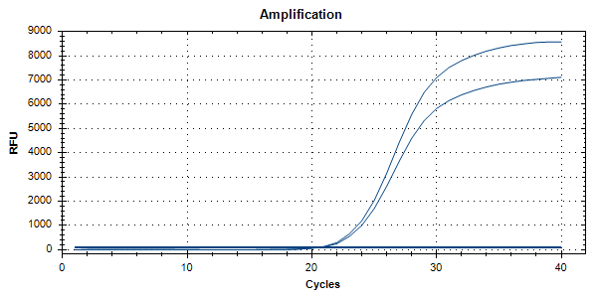
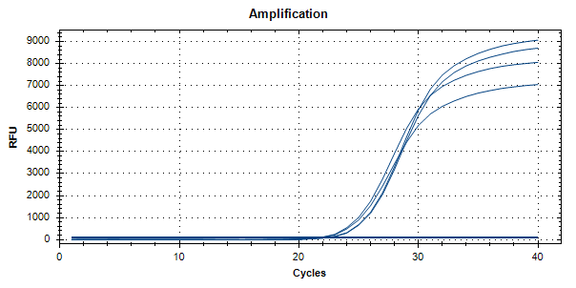


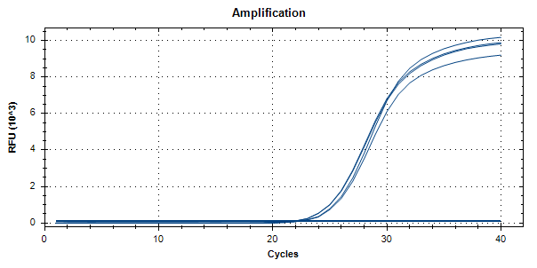
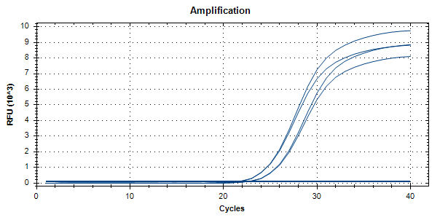
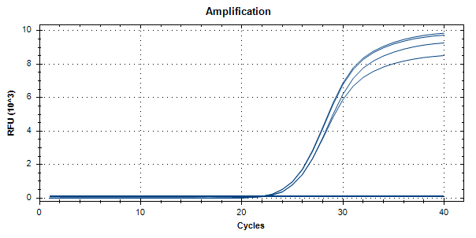



Threshold : 100
Comparison Between E Lysis Buffers Variations
E Lysis buffer:
NaOH
Ethanol
EDTA
QIAmp Kit
Original E Lysis Buffer
80ºC Has lower signal
RT Has lower signal
RT Has lower signal
E Lysis Buffer using Conc. NaOH
Original E Lysis Buffer + SDS
Original E Lysis Buffer + SDS + NP40
Notes:
Conclusion: Adding the different chemicals did not make significant changes to the original lysis buffer in terms of extraction efficiency. Heating the lysis buffer at 80ºc shows a slightly lower ct as compared to room temp.

Slide 18
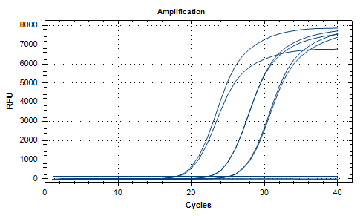
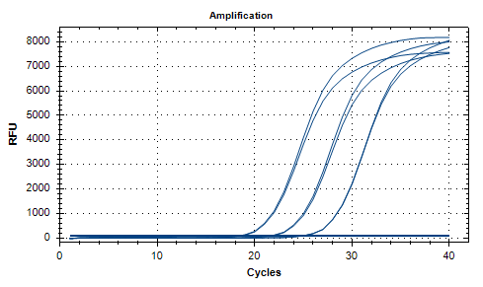






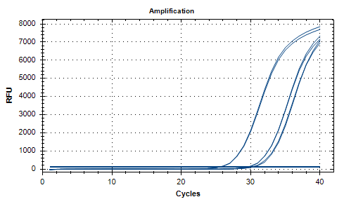
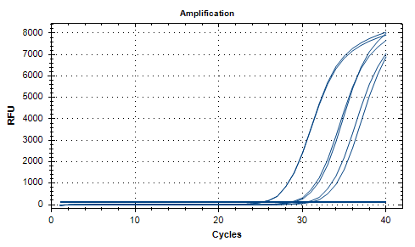






Experiments run prior.
Threshold : 100
Comparison Between E Lysis Variations
QIAmp Kit
Original E Lysis Buffer
E Lysis Buffer + Spiked sample w 0.22um filter
E Lysis Buffer (Heated @80ºC) + Spiked sample w 0.22um filter
Notes:
Conclusion: Heating the lysis buffer before flushing did not make significant differences to the amount of E. coli captured.

Slide 19
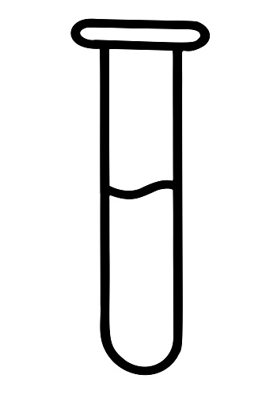
Previously: Comparison of Extraction protocol overview
Bacterial Culture
Pick colony (s) into 3mL LB
Grow at 37degC, 200 rpm for ~16 hr
Volume aliquote for extraction
Bacterial gDNA Extraction: QIAamp DNA mini kit (column)
QIAamp DNA mini kit consumables
Treatment 1 Reagent 1+Proteinase K
Treatment 2 Reagent 2
Add Ethanol
1
56degC for 1-3 hr.
2
70degC for 10 mins.
3
Est. ~20-30 mins.
*2 heating temperature for =< 75mins
To have substantial amount of e. coli for testing.
Treatment 1
Lysis buffer 1
QIAamp DNA mini kit consumables
gDNA Quantification
Nanodrop
Qubit
1
80degC for 10 mins.
Bacterial gDNA Extraction: Prepared Lysis Buffer + column
Est. ~20-30 mins.
* 1 heating temperature for 10 mins
E Lysis buffer:
NaOH
Ethanol
EDTA

Slide 20
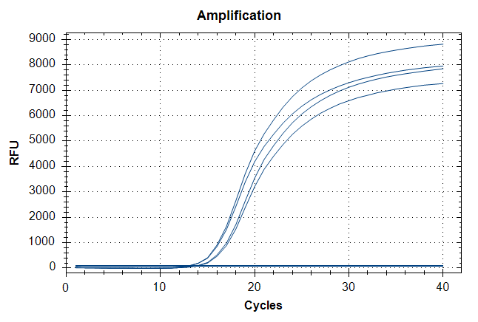
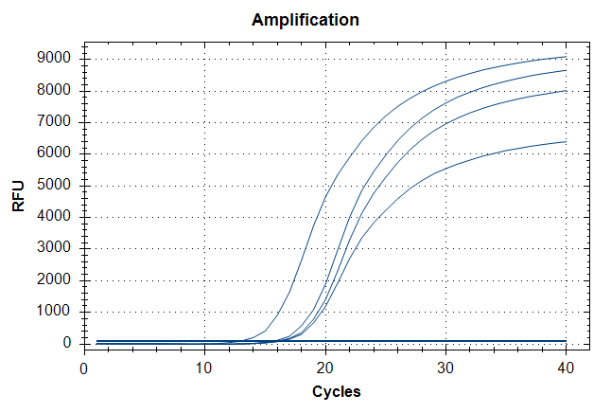
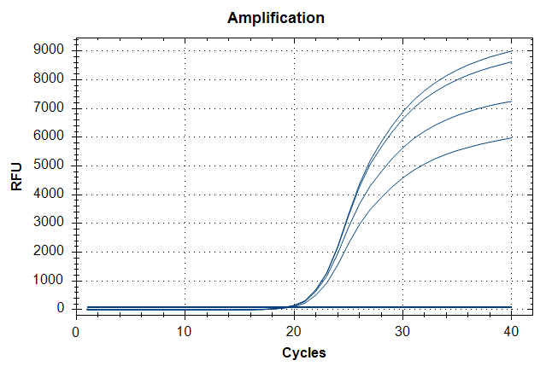



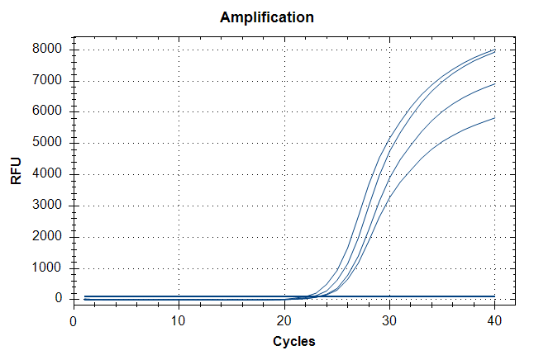
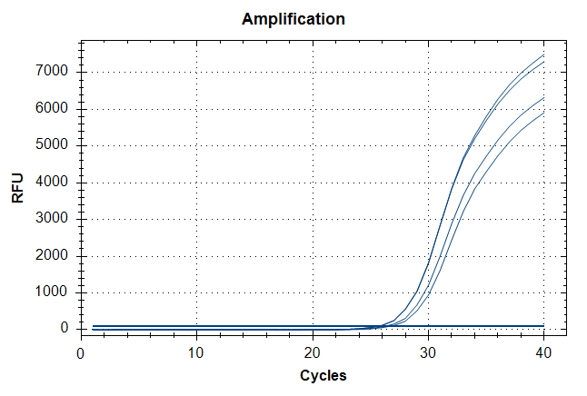
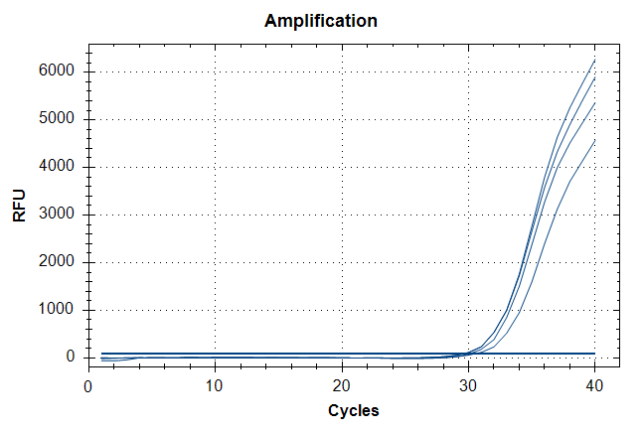



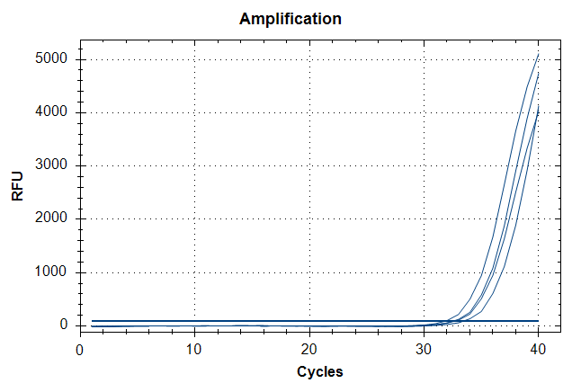

Comparison of Extraction protocol: qPCR detection of UidA (E. coli)
Highest titer
EC 100 µL
EC 10 µL
EC 1 µL
E Lysis buffer
QIAamp
QIAamp
E Lysis buffer
E Lysis buffer
QIAamp
EC 0.1 µL
EC 0.01 µL
EC 0.001 µL
E Lysis buffer
E Lysis buffer
E Lysis buffer
QIAamp
QIAamp
QIAamp
EC 0.0001 µL
E Lysis buffer
Note:
qPCR detection demonstrated that the extraction efficiency of E lysis protocol with reference protocol (QIAamp DNA mini kit) were comparable with ~1 ct difference.
QIAamp
Lowest titer

Slide 21
Advantages of Prepared buffer protocol:
1. Flexible in modification of lysis buffer for optimization
2. Shorter duration of extraction from bacterial cells (10 mins instead of 75 mins)
3. 100 µL of sample (No need to centrifuge for pellet) can be processed directly.
4. Currently, 1 heating temperature (80 degC) as compared to reference protocol (56 & 70 degC).
Disadvantages of Prepared buffer protocol:
1. May be inefficient in extracting cell pellet with E Lysis buffer; ~50% (nanodrop)
qPCR difference
QIAamp
E Lysis
buffer
EC pellet
Subsequent Plans:
Optimization of Prepared Lysis buffer
1. Temperature: RT vs 70degC (10mins) vs 80 degC (10mins) vs 90 degC (10mins)
2. Modification (Addition of detergent etc.)
Direct Sample extraction vs Filtered Sample Extraction;
1. Syringe membrane filter (0.2um) may be used to trap Bacterial cells (I.e. E. coli) from water sample (Spiked-in samples).
2. Lysis of cells within the membrane filter using modified buffer.
3. Determine % of yield loss.

Slide 22
Membrane Filtration: Syringe filter with 10 mL spiked in sample
(0.2µm & 0.45µm) (Heating)
1. Spiked in E. coli in 10mLMiliQ water
2. Filter water sample through syringe filter
4. Reverse lysis buffer through the same filter
QIAamp DNA mini kit consumables
1
2
4
Either
0.2 µm or 0.45 µm
3. Heat lysis buffer to 80degC
Heating Before
5
3
1. Spiked in E. coli in 10mLMiliQ water
2. Filter water sample through syringe filter
3. Reverse lysis buffer through the same filter
4. Heat 80degC for 10 minutes
QIAamp DNA mini kit consumables
1
2
3
4
Either
0.2 µm or 0.45 µm
Either
500 / 800 / 1000 µL
5
Heating After
To compare filtration workflow using 0.2 & 0.4um SF and determine yield loss in extraction
To assess the performance of using different volume of E lysis buffer

Slide 23
Membrane Filtration: Syringe filter(SF) with 10 mL spiked in sample (Reverse) – Heating before and Heating after
Heating the lysis-sample solution After (Reverse) reduce the ct difference as compared to Reference
Sample preparation using 0.4um syringe filter generally has a better performance
Notes:
20220518R2

Slide 24
Membrane Filtration: Syringe filter(SF) with 10 mL spiked in sample (Reverse)(Heating after) E lysis vs ES lysis
Note:
Lesser volume observed in lysis buffer-sample collection
Able to reproduce previous results; showing that after heating works better.
ct difference: Direct extraction & syringe filtration are closer in E lysis case;
ct detection based on Lysis efficiency: (1) ES is better than E based on ct value
1mL usage of lysis buffer will be better for consistencyi
Est. Cost per mL: $0.151
Notes:
20220519R1

Slide 25
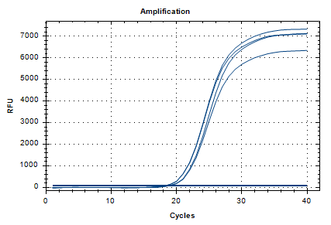
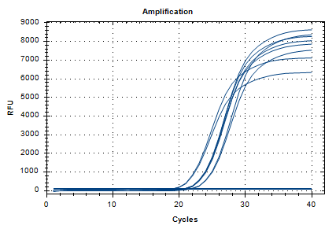
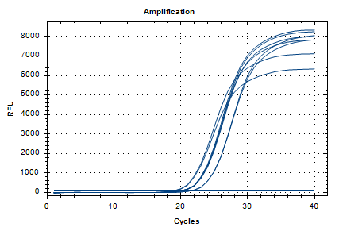
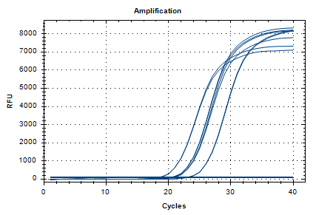

Membrane Filtration: Syringe filter(SF) with 10 mL spiked in sample (Reverse)(Heating after) E lysis vs ES lysis
Direct
E: SF0.2
E: SF0.4
0.5 mL
0.5 mL
0.5 mL
0.8 & 1 mL
0.8 & 1 mL
0.8 & 1 mL
Direct Ex
Direct Ex
Direct Ex
ES: SF0.2
ES: SF0.4
0.5 mL
0.5 &0.8 mL
0.8 & 1 mL
1 mL
Direct Ex
Direct Ex

Slide 26


Slide 27




Example of air-sampling unit mentioned in article

