Slide 1
Water quality monitoring for
Legionella pneumophila and Escherichia coli

Slide 2
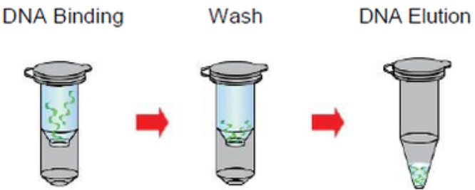
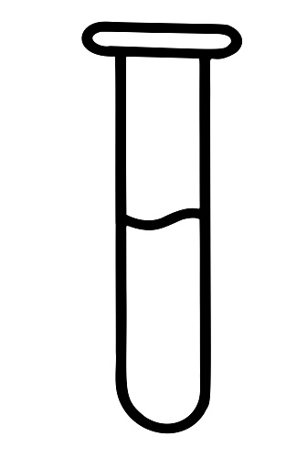
Comparison of Extraction protocol overview
Bacterial Culture
Pick colony (s) into 3mL LB
Grow at 37degC, 200 rpm for ~16 hr
Volume aliquote for extraction
Bacterial gDNA Extraction: QIAamp DNA mini kit (column)
QIAamp DNA mini kit consumables
Treatment 1 Reagent 1+Proteinase K
Treatment 2 Reagent 2
Add Ethanol
1
56degC for 1-3 hr.
2
70degC for 10 mins.
3
Est. ~20-30 mins.
*2 heating temperature for =< 75mins
To have substantial amount of e. coli for testing.
Treatment 1
Lysis buffer 1
QIAamp DNA mini kit consumables
gDNA Quantification
Nanodrop
Qubit
1
80degC for 10 mins.
Bacterial gDNA Extraction: Prepared Lysis Buffer + column
Est. ~20-30 mins.
* 1 heating temperature for 10 mins
E Lysis buffer:
NaOH
Ethanol
EDTA

Slide 3
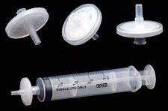
Spiked in Extraction protocol (Syringe Filter)
Bacterial Culture
Pick colony (s) into 3mL LB
Grow at 37degC, 200 rpm for ~16 hr
Volume aliquot for extraction
1. Prepare 10ml MiliQ water + Bacterial Culture
2. Filter water sample through syringe filter
3. Filter E lysis buffer through the same filter
1
2
Either 0.2um or 0.45 um filter
3
455ul vs 1ml of Lysis Buffer
To have substantial amount of e. coli for testing.
QIAamp DNA mini kit consumables
4
100ul of sample is eluted out

Slide 4
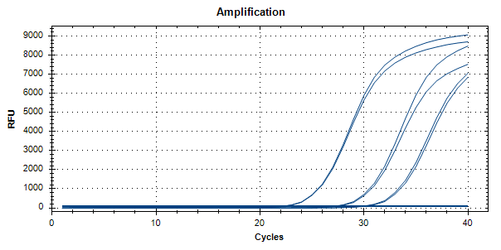
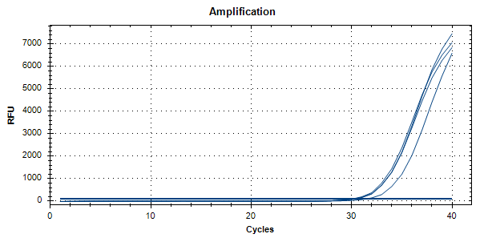
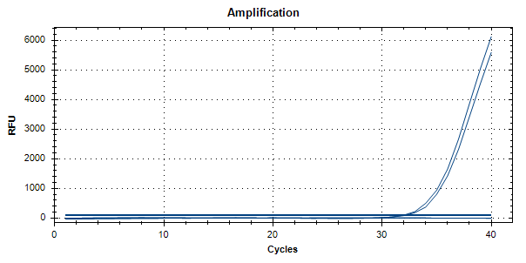
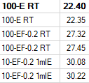


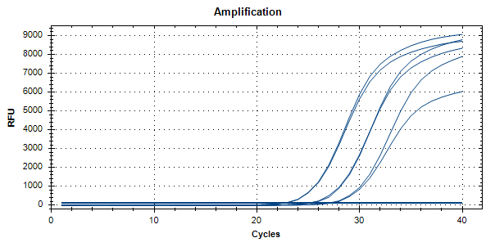
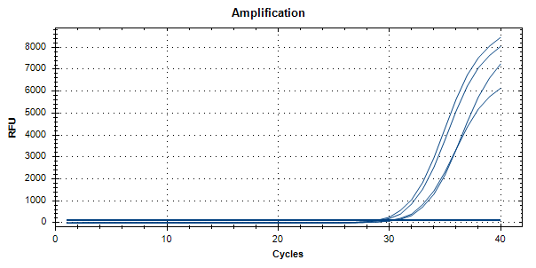
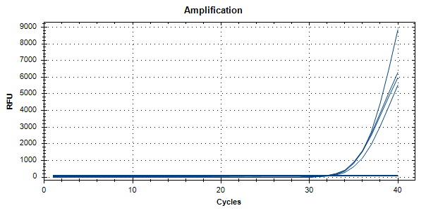
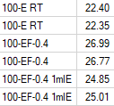


Threshold : 100
Comparison Between 0.2um Filter and 0.45um Filter
Note: Using 0.4um Filter flushed with 1ml of lysis buffer gave the best results but further optimization should be carried out.
Notes:
20ul of culture was spiked into 4ml of culture. = 100ul culture. To compare dna yield extracted, the volume of lysis tested was 455ul and 1ml. Conclusion: Using 0.4um Filter flushed with 1ml of lysis buffer gave the best results. Further optimization can be carried out by increasing the contact time of the lysis buffer with the membrane. (Use a larger volume of lysis buffer or let the lysis buffer stay on the membrane for a certain time before flushing out)

Slide 5
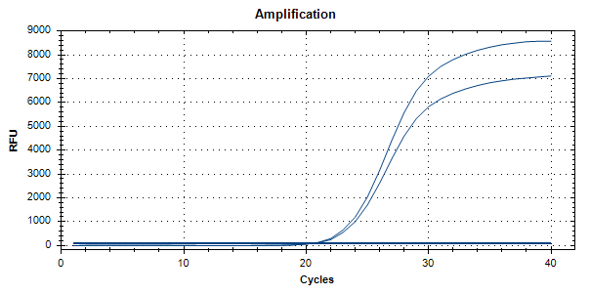
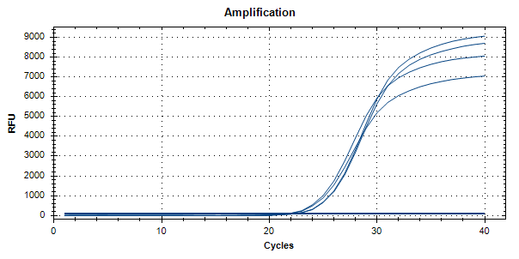


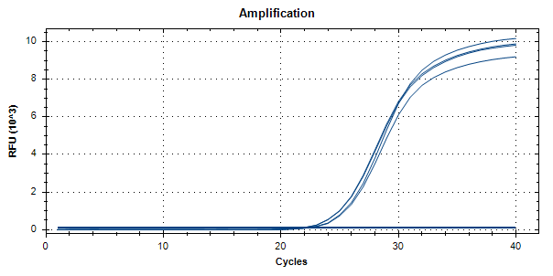
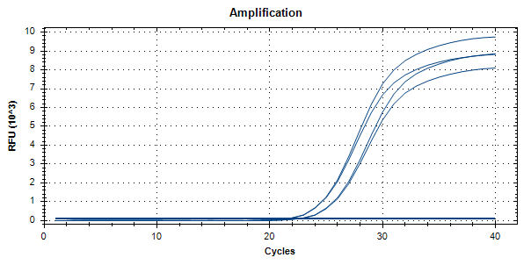
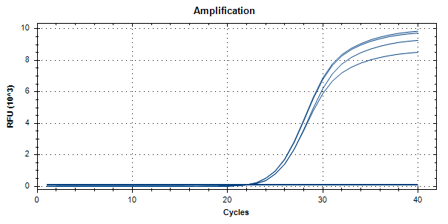



Threshold : 100
Comparison Between E Lysis Variations
E Lysis buffer:
NaOH
Ethanol
EDTA
QIAmp Kit
Original E Lysis Buffer
80ºC Has lower signal
RT Has lower signal
RT Has lower signal
E Lysis Buffer using Conc. NaOH
Original E Lysis Buffer + SDS
Original E Lysis Buffer + SDS + NP40
Notes:
Conclusion: Adding the different chemicals did not make significant changes to the original lysis buffer in terms of extraction efficiency. Heating the lysis buffer at 80ºc shows a slightly lower ct as compared to room temp.

Slide 6
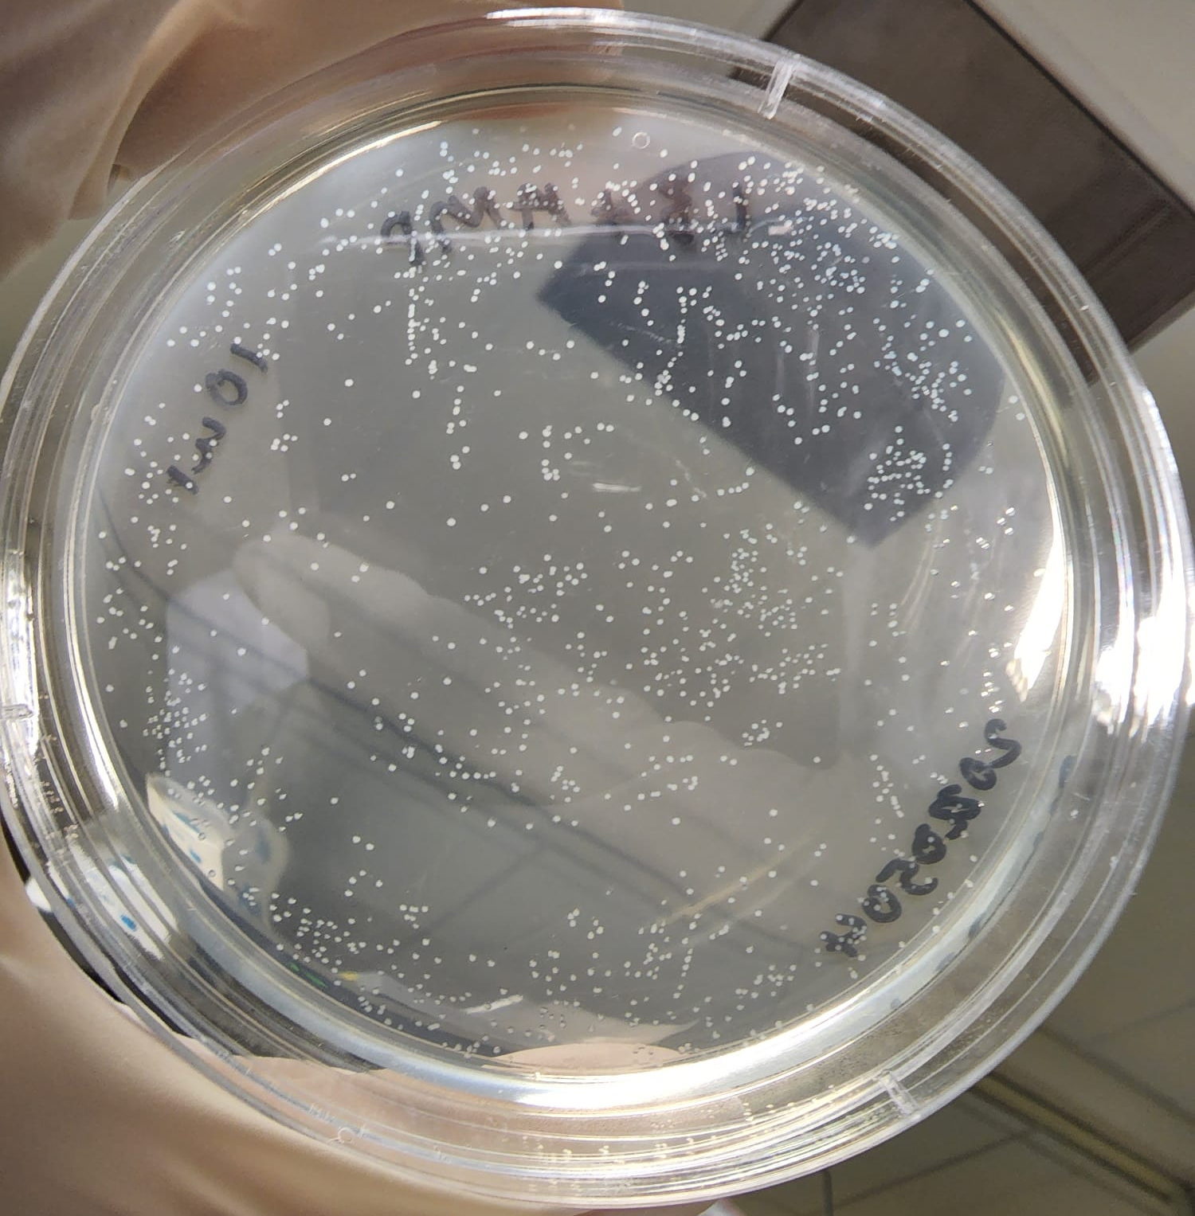
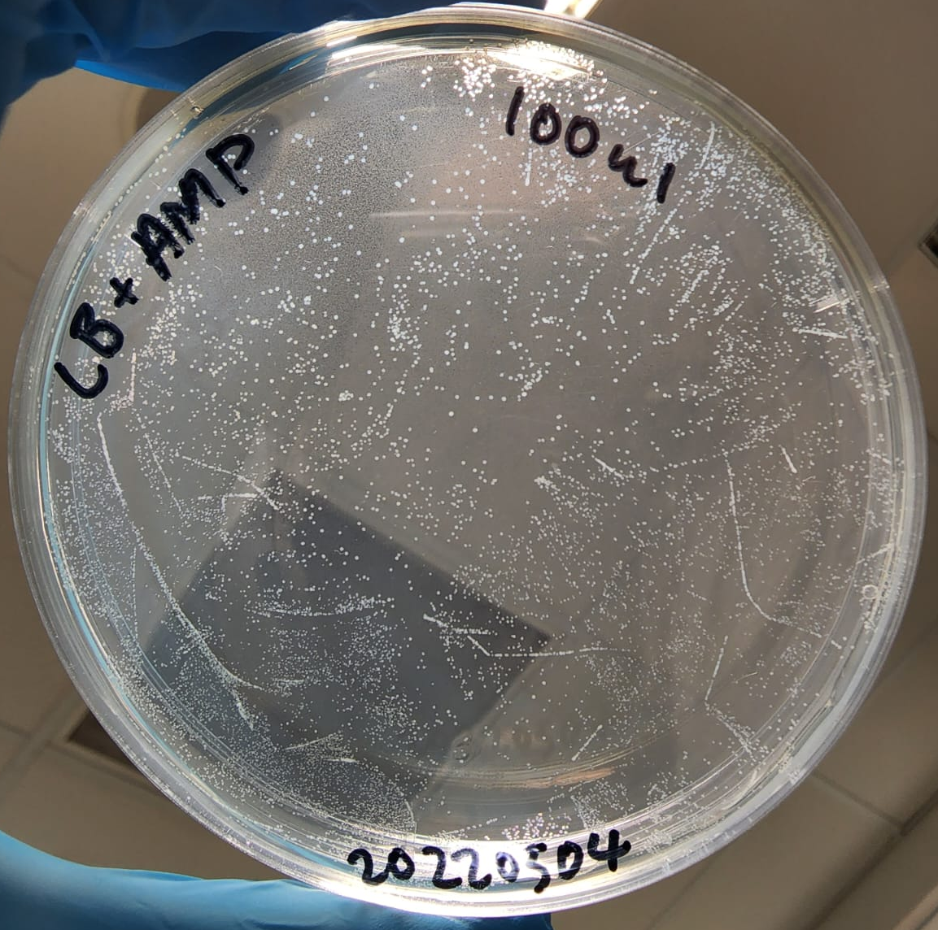
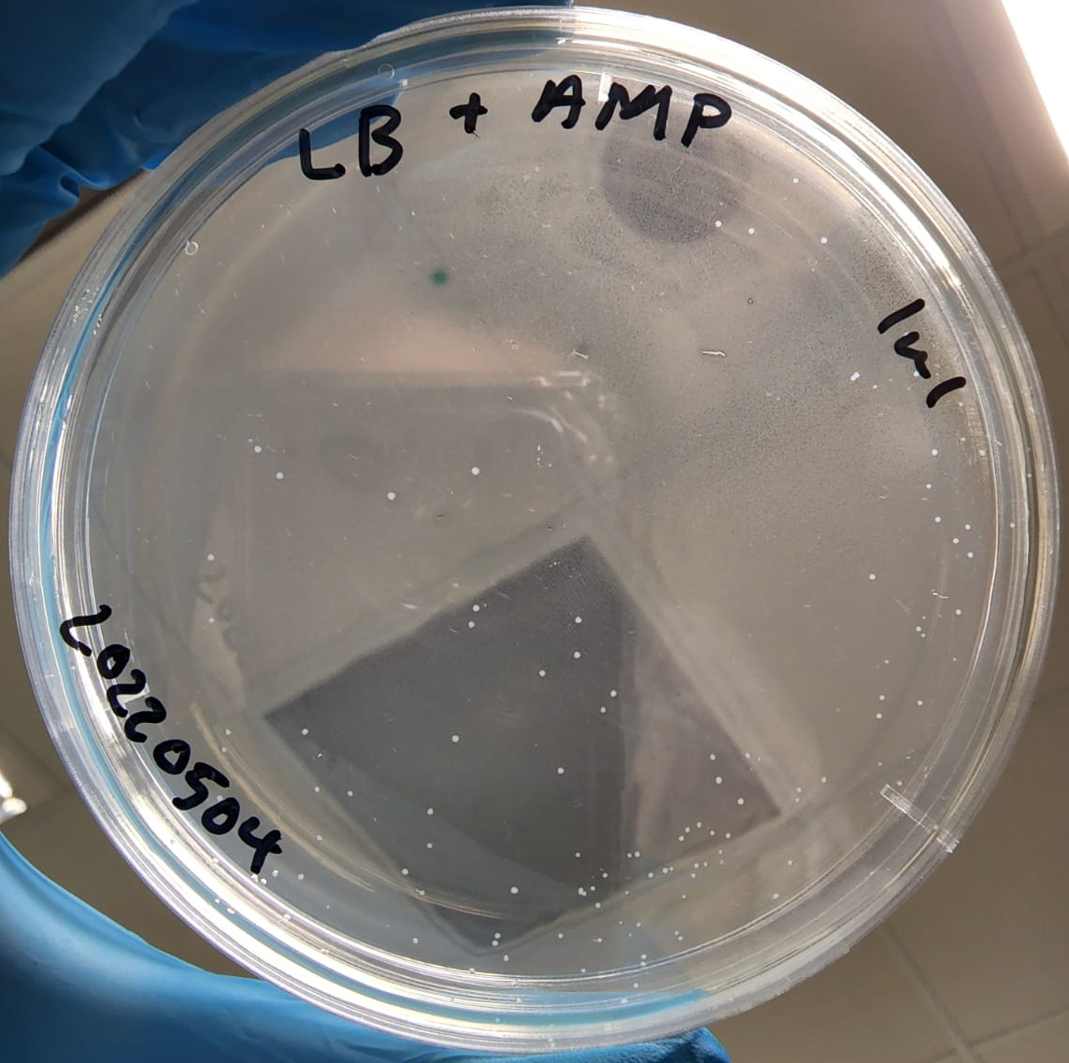
Bacterial Counting: 1 µL, 10 µL, 100 µL volume of E .coli stock
63
49
47
30
54
36
31
Plating volume:
100µL E.coli stock
Plating volume:
1µL E.coli stock + 99µL Media
Plating volume:
10µL E.coli stock + 90µL Media
Estimated Total Count:
= 125 * 100
= 12500
Calculated Total Count:
= 125
Calculated Total Count:
= 4* (63+49+47+54+30+31+36)
= 4*310
= 1240

Slide 7
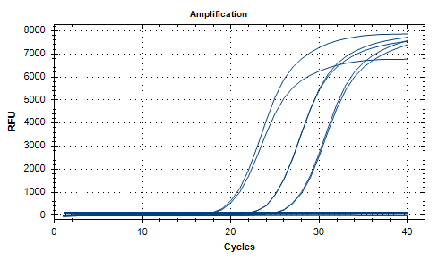
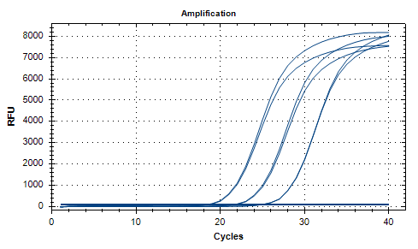






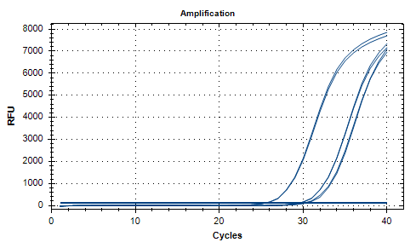
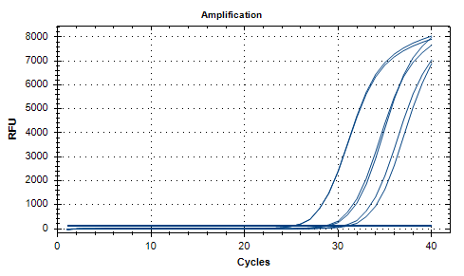






Experiments run prior.
Threshold : 100
Comparison Between E Lysis Variations
QIAmp Kit
Original E Lysis Buffer
E Lysis Buffer + Spiked sample w 0.22um filter
E Lysis Buffer (Heated @80ºC) + Spiked sample w 0.22um filter
Notes:
Conclusion: Heating the lysis buffer before flushing did not make significant differences to the amount of E. coli captured.

Slide 8
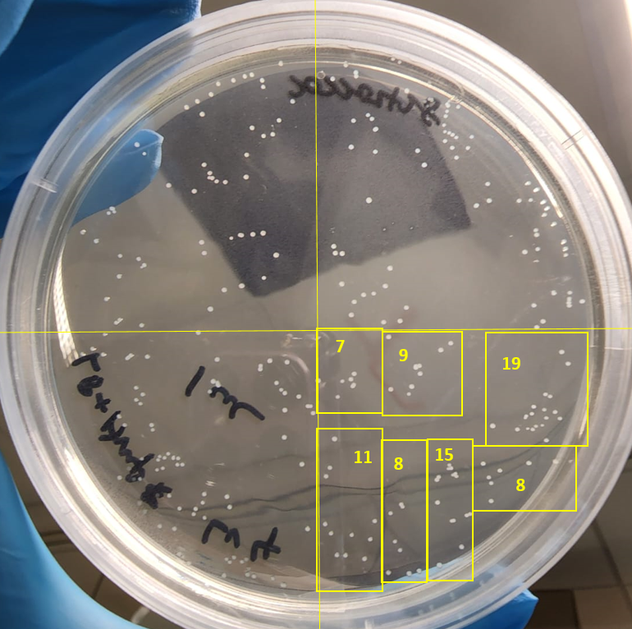
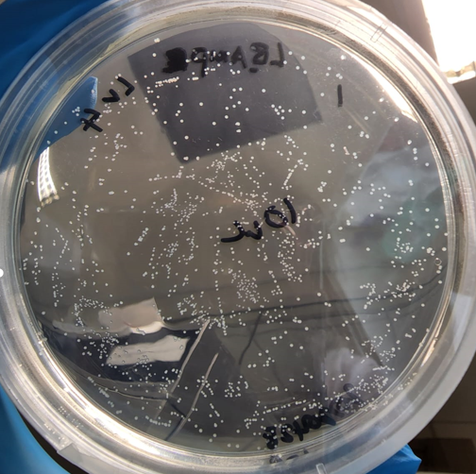
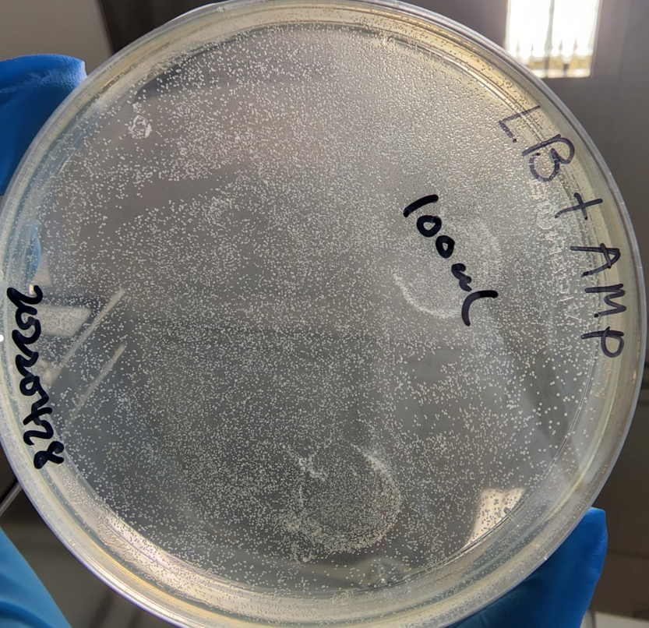
Bacterial Counting: 1 µL, 10 µL, 100 µL volume of E .coli stock
Plating volume:
10µL E.coli stock + 90µL Media
Plating volume:
100µL E.coli stock
Estimated Total Count:
= 308 * 10
= 3080
Estimated Total Count:
= 308 * 100
= 30800
Plating volume:
1µL E.coli stock + 99µL Media
Calculated Total Count:
= 4* (7+9+19+11+8+15+8)
= 4*77
= 308

Slide 9
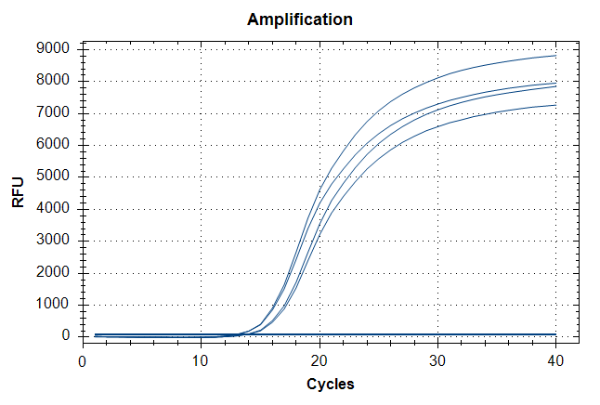
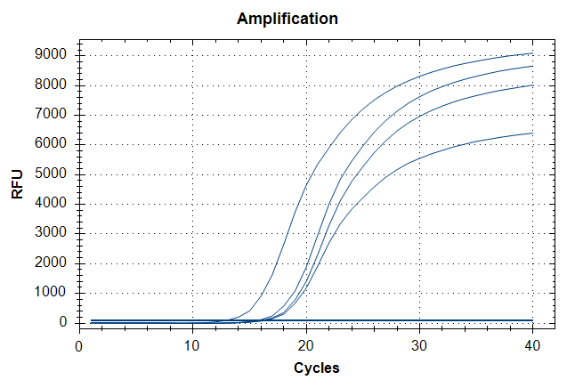
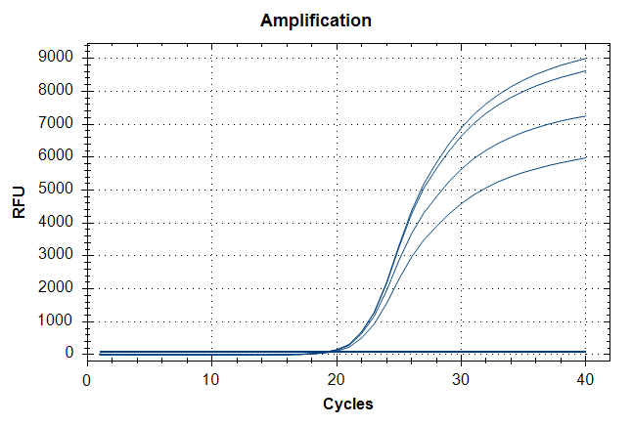



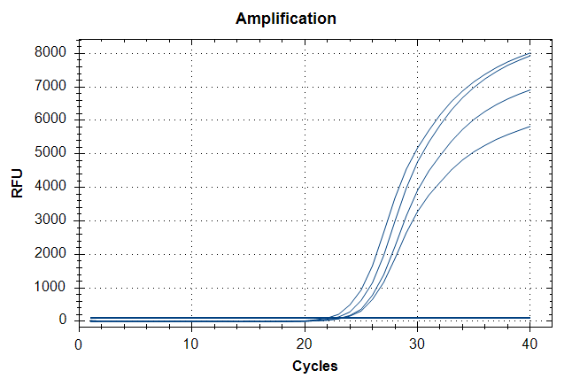
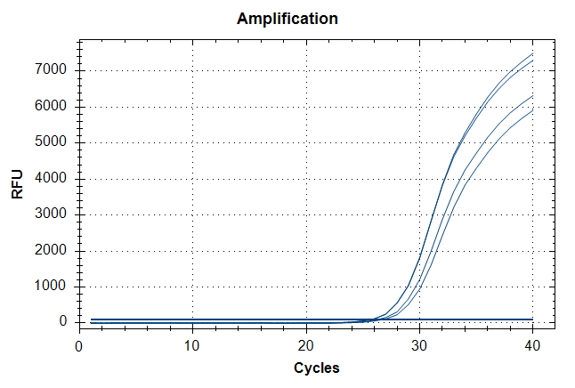
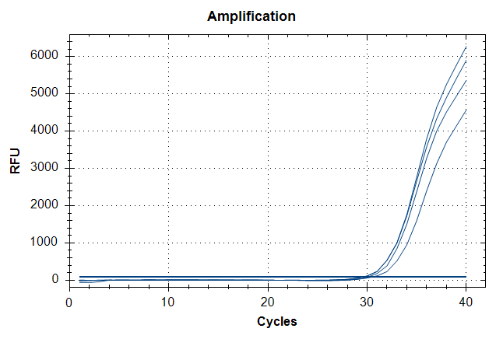



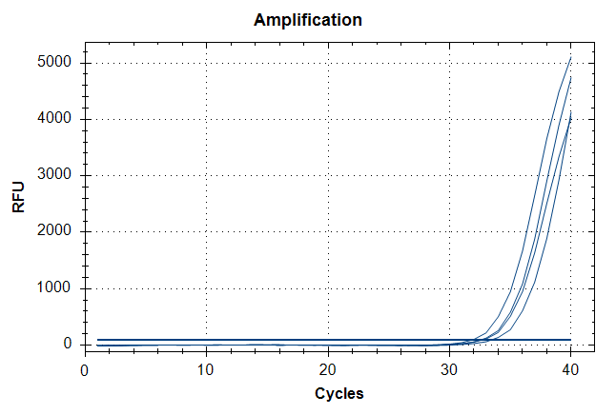

Comparison of Extraction protocol: qPCR detection of UidA (E. coli)
Highest titer
EC 100 µL
EC 10 µL
EC 1 µL
E Lysis buffer
QIAamp
QIAamp
E Lysis buffer
E Lysis buffer
QIAamp
EC 0.1 µL
EC 0.01 µL
EC 0.001 µL
E Lysis buffer
E Lysis buffer
E Lysis buffer
QIAamp
QIAamp
QIAamp
EC 0.0001 µL
E Lysis buffer
Note:
qPCR detection demonstrated that the extraction efficiency of E lysis protocol with reference protocol (QIAamp DNA mini kit) were comparable with ~1 ct difference.
QIAamp
Lowest titer

Slide 10
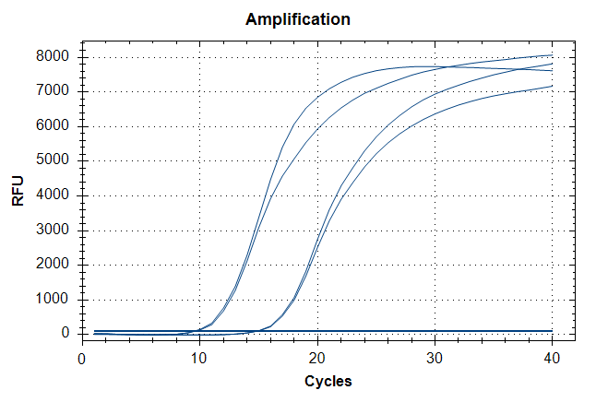
Advantages of Prepared buffer protocol:
1. Flexible in modification of lysis buffer for optimization
2. Shorter duration of extraction from bacterial cells (10 mins instead of 75 mins)
3. 100 µL of sample (No need to centrifuge for pellet) can be processed directly.
4. Currently, 1 heating temperature (80 degC) as compared to reference protocol (56 & 70 degC).
Disadvantages of Prepared buffer protocol:
1. May be inefficient in extracting cell pellet with E Lysis buffer; ~50% (nanodrop)
qPCR difference
QIAamp
E Lysis
buffer
EC pellet
Subsequent Plans:
Optimization of Prepared Lysis buffer
1. Temperature: RT vs 70degC (10mins) vs 80 degC (10mins) vs 90 degC (10mins)
2. Modification (Addition of detergent etc.)
Direct Sample extraction vs Filtered Sample Extraction;
1. Syringe membrane filter (0.2um) may be used to trap Bacterial cells (I.e. E. coli) from water sample (Spiked-in samples).
2. Lysis of cells within the membrane filter using modified buffer.
3. Determine % of yield loss.

