Slide 1
Water quality monitoring for
Legionella pneumophila and E. Coli

Slide 2
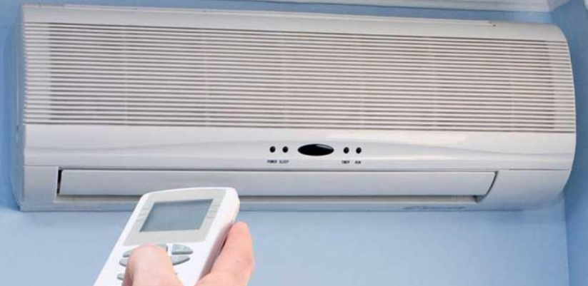
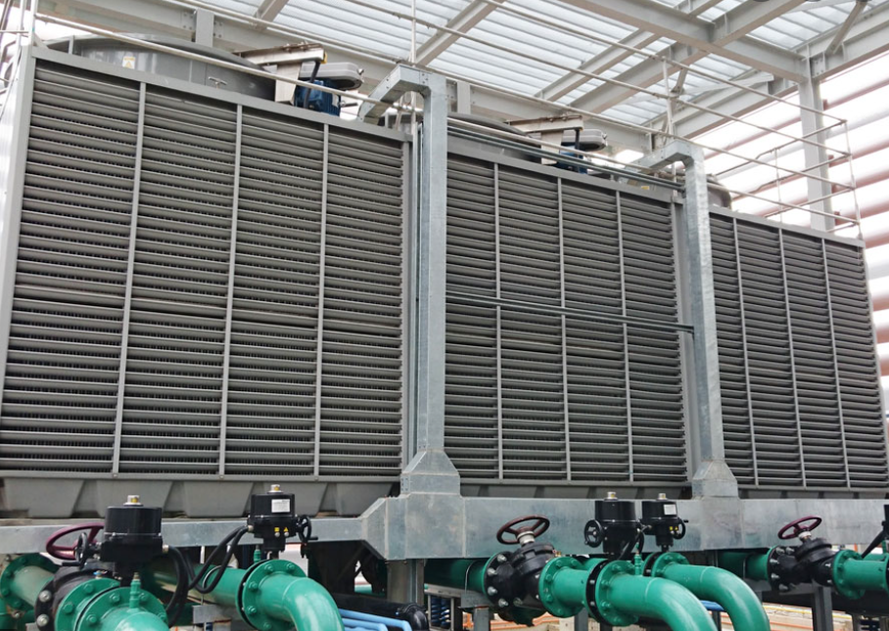
Water quality monitoring for pathogens: E. coli and Legionella
Area of Disinfection
Water Tanks;
Cooling towers;
Air conditioner
Disinfectant used by client company
H²O²
Objectives of this project
Legionella detection Assay
E. Coli detection Assay
ISO certification attainment
ISO 11731:2017 - Water quality — Enumeration of Legionella
ISO 9308-1:2014 Water quality — Enumeration of Escherichia coli and coliform bacteria
Specific Objectives
Development of PCR/ dPCR
Development of LAMP
Sample Preparation of specimen type
  Water sample
  Swab sample
  Air sample (bioaerosol)
Determine if bacteria detected is viable
Detect other bacteria present

Slide 3






People involved in this project
Assay Design & Sample Preparation Development
Sandro
Su Yan
Ken
Nathalie
Operators supporting the project
Angelina
Harshinie
Nathalie
Ken
Notes:
To what concentration is legionella infectious.

Slide 4
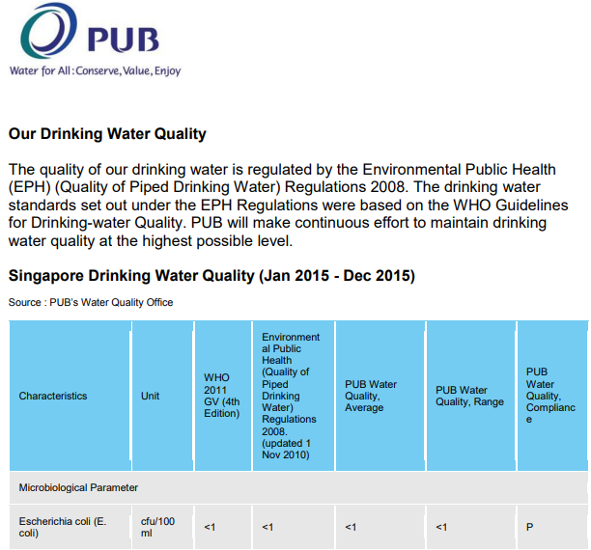

Bacterial Acceptance Criteria
v
Environmental Public Health (Cooling Towers And Water Fountains) Regulations 2001
a standard plate count that does not exceed 100,000 colony-forming units per milliliter
a legionella bacteria count that does not exceed 10 colony-forming units per milliliter
Singapore PUB Water Quality: E.coli Monitoring standards
Drinking water standards set out under EPH regulations were based on WHO guidelines for drinking-water Quality
E. coli detection = <1 of CFU per 100ml
Legionella detection = <10 of CFU per 1ml
Notes:
https://www.pub.gov.sg/Documents/Singapore_Drinking_Water_Quality.pdf
does cooling tower have a diff acceptance criteria for e.coli - cant find
Size 2 to 20 μm
CFU – Colony-forming unit → It estimates the number of bacteria or fungal cells in a sample which are viable, able to multiply via binary fission under the controlled conditions
https://www.nea.gov.sg/docs/default-source/our-services/environmental-public-health-(cooling-towers-and-water-fountains)-regulations-(180-kb).pdf

Slide 5
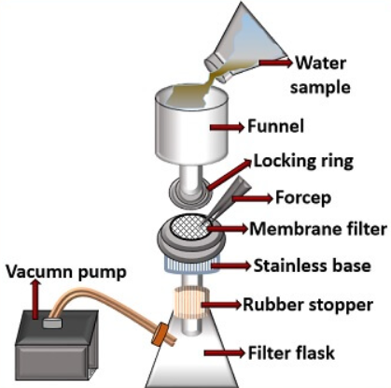
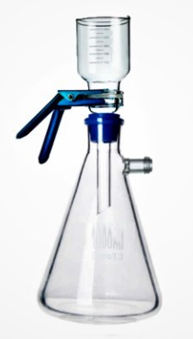
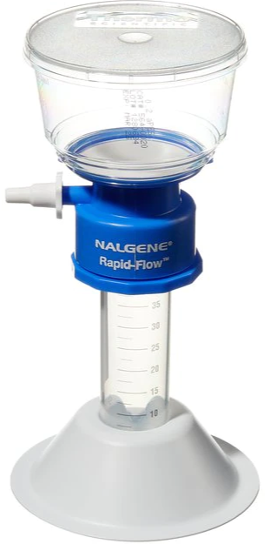
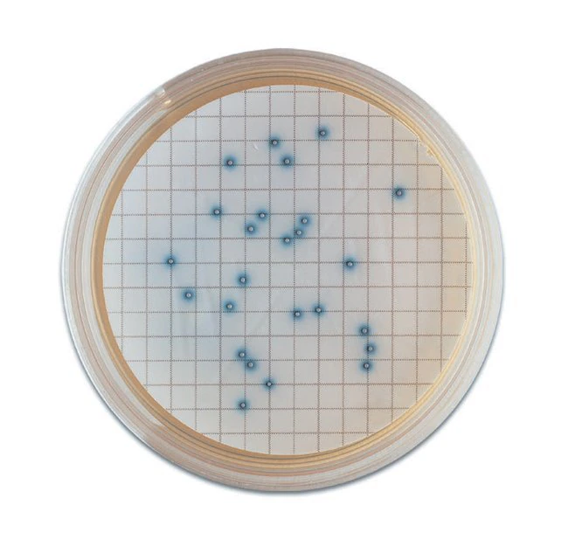
Conventional method of detection: Water specimen type
a)
b)
Bacteria Culture
Membrane filtration method: (Common)
Water sample collected ~100ml
Size ≤0.22µm
Place membrane in between locking ring (a)
Supported with vacuum pump
Membrane filter extracted for culture in petri dish
Preparation of appropriate (specific) media
Culture growth of 24-48 hours
Visual detection
Not all strain are cultural with media
Sample processing and detection time is long

Slide 6
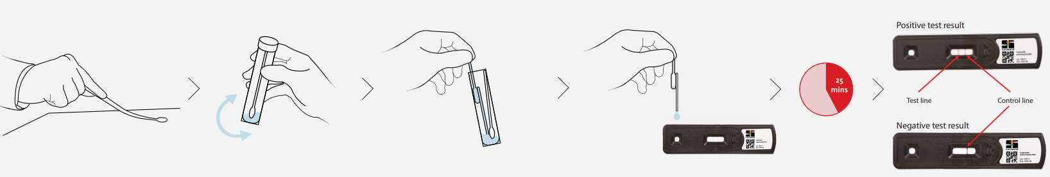
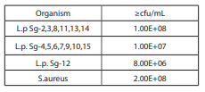
Biofilm Swab: Commercially Available kit
Lovibond® Water Testing , Swab (Single) Legionella Test™ Kit
Protocol:
- Similar to an ART kit, after swabbing a minimum area of 10cm2, the swab is inserted into a recovery buffer vial.
A small amount of sample is released onto the test strip
Results after 25 minutes
Two RED lines across the result window indicate presence of Legionella Pneumophila serogroup 1
Limit of Detection
200 CFU/l/ Swabbed area
This kit is designed to test for Legionella on surfaces and biofilms in risk areas identified by CDC* such as:
Domestic and industrial hot and cold water systems.
Cooling towers and water tanks.
The Lovibond® Legionella TestTM has been shown to produce weak positive results with other legionella pneumophila serogroups at the cfu/mL stated in the above table.
Notes:
https://www.lovibond.com/ix_pim_assets/Wasseranalytik/Instruction_Manuals/Schnelltests/Standard_Test_Kits/Legionellen/Swab_Test_Kit/Lovibond%20Single%20Swab%20Instructions%201218.pdf

Slide 7
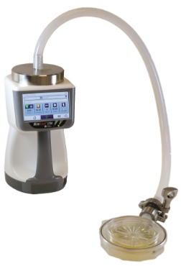
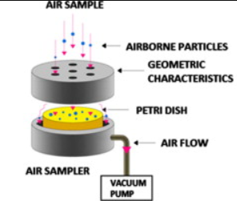
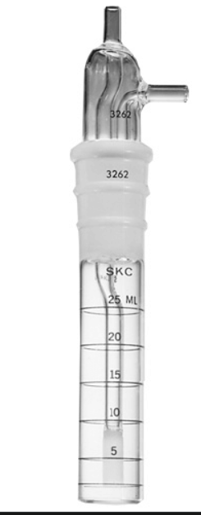
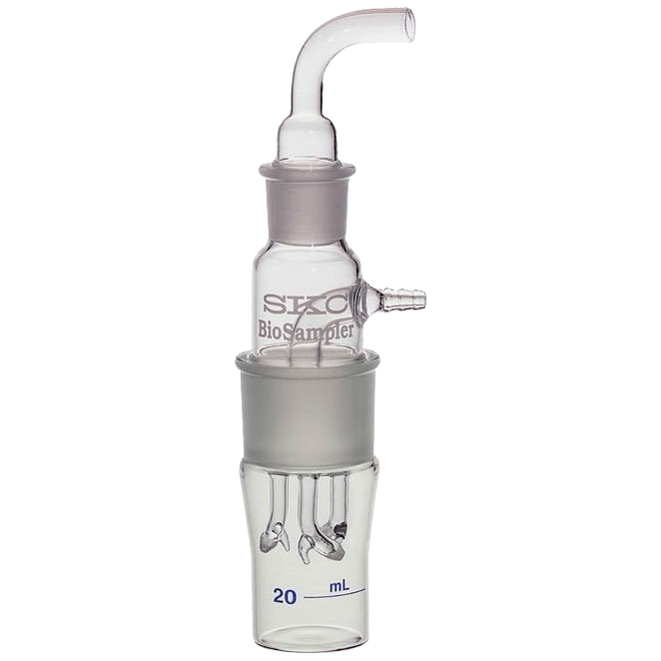
Conventional method of detection : Air sampling Bioaerosol
Filtration and filter-based samplers
  Collection of airborne particles on filter with or without the help of vacuum pump
Impaction based samplers
  The usage of inertia of particles’ aerodynamics onto impaction surface with the help of vacuum pump
    Agar-based impactors (onto agar plates etc.)
Liquid based sampler
  Similar to impactors; inertia is used to deposit them into a liquid collection medium
    AGI (All-glass impingers); d50 of 0.3 um; but water evaporates 90mins
    liquid-based swirling air sampler; impingers with centrifugal force (Biosampler; SKC inc.)
    Cyclones type (wetted-wall cyclone collection; 100 to 1000 L/min to suspend particles)
Electrostatic collector or precipitator (ESP)
  Particle drawn was imparted an electrostatic charge and deposited onto a collection medium by electrostatic attraction or repulsion. *Less microorganism damage*
Agar-based impactor
Microbial Monitor: BioCapt® Single-Use
AGI
Biosampler

Slide 8
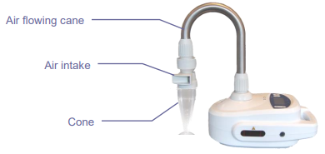
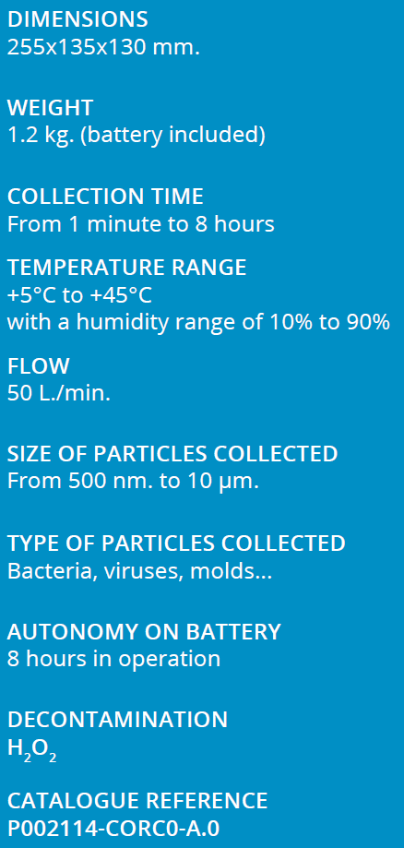
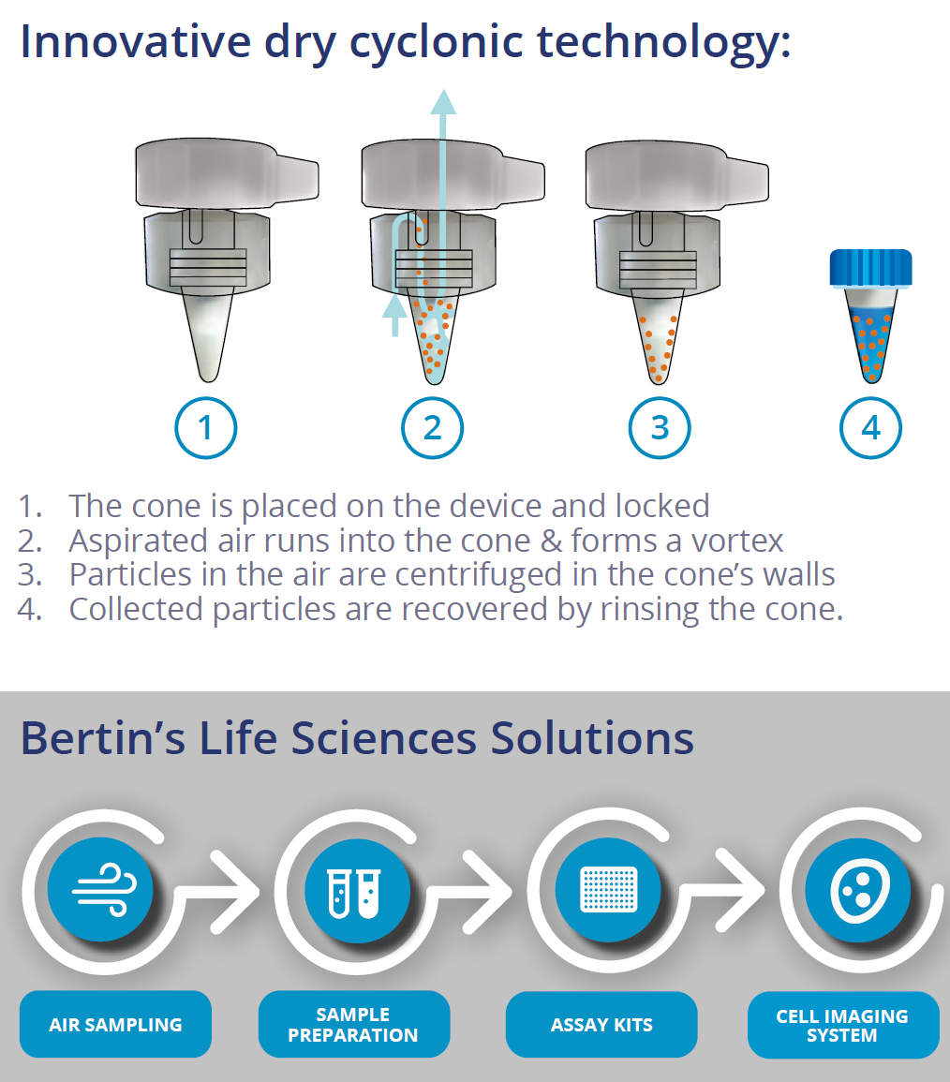
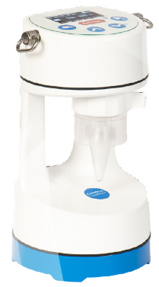
Commercially Available Air Sampling Device: Liquid impactor
Product 1: Bertin Coriolis-air sampler
Portable Dry cyclonic Air Sampler
Coriolis® patented technology: based on a cyclone type operation, it concentrates airborne biological particles into a liquid sample.
Product 2: Portable Dry cyclonic Air Sampler
Concentrated sample compatible with any downstream analysis
Light & Compact for indoor & Outdoor use
High efficiency with up to 8 hours of autonomy
Develop a simplified handheld/ portable device with cyclonic technology?
Coupled it with a color-changing detection assay for on-site testing?

Slide 9
Portable Device for Aerosol Sample
5
(2)
Module 1: (1) Air inlet adaptor with spiral groove for screw cap tube (3D designed)
Module 2: (1) Screw cap tube: 50 mL/ 5mL/ 1.5mL etc.
  Liquid collection medium for lysis & nucleic acid extraction
Module 3: Vacuum pump unit with battery casing (Similar blueprint of pipette gun/ controller?)
Module 4: Simple display and setting (Duration, Flow Rate, Battery etc.)
Module 5: (2) Attachment slot for filter membrane for entrapment instead of cyclone; filter paper removed for lysis and nucleic acid extraction.
Overall Casing for module 3 & 4
Module 5 could be remodified for water sampling device
4. Simple Display
1. Air inlet adaptor (Cyclone)
2.Screw cap tube
(1)
3. Vacuum Pump unit with Battery casing

Slide 10
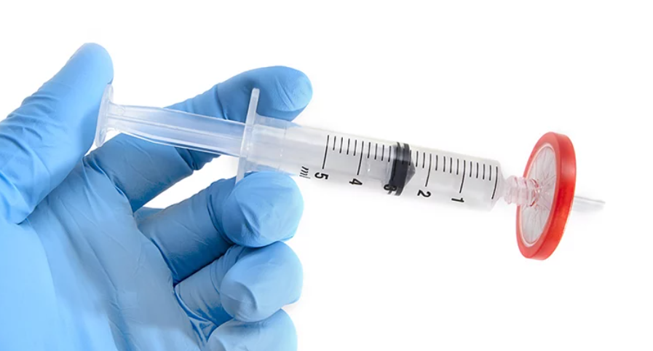
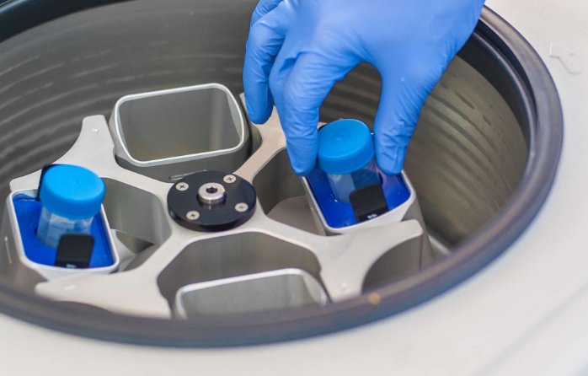

Other proposed methods from Sample Preparation
Water sample
Swabs specimen
Membrane filtration method:
Size ≤0.22µm
Syringe-filter to trap bacteria (size)
Filter through ~500uL of lysis buffer slowly
Solution heated for 5 mins at 98degC
PCR/ LAMP test
Simple Centrifugation method:
Centrifuge in 50ml Falcon tube ~4000 to 6000 rpm
Remove as much supernatant, and combined multiple pellet into one single tube
Repeat step 1
Add lysis buffer
Solution heated for 5 mins at 98degC
PCR/ LAMP test
Multiple swab in lysis buffer(tube)
Incubate swabs in lysis buffer/ Collection media
Remove swabs
Solution heated for 5 mins at 98degC
PCR/ LAMP test
Lysis Buffer: e.g. Abara Lysis buffer; Collection medium for bacteria

Slide 11
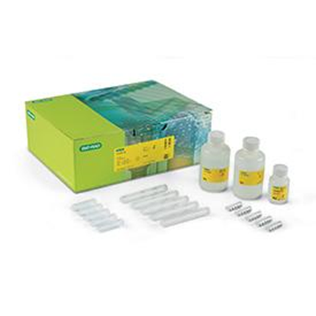
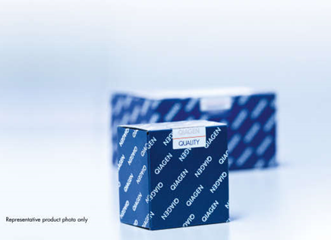
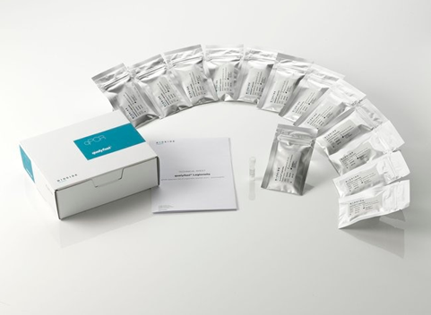
Commercially Available Extraction Kits for Nucleic Acid Extraction
Bio Rad - Aquadien™ Bacterial DNA Extraction and Purification Kit
Applicable for both Legionella
& E. coli Extraction
Suitable for: Bacterial DNA extraction from water samples, Aerosols & Biofilms
QIAGEN- DNeasy PowerWater Kit
Applicable for both Legionella
& E. coli Extraction
Suitable for: Bacterial DNA extraction from water samples only
Price : USD 1077
Thermo Scientific - qualyfast ® DNA Extraction kit I / II
Applicable for both Legionella
& E. coli Extraction
Suitable for: Bacterial DNA extraction from Clear/dirty water samples and sediments
Notes:
https://www.bio-rad.com/en-sg/sku/3578121-aquadien-bacterial-dna-extraction-purification-kit?ID=3578121
https://www.qiagen.com/us/products/discovery-and-translational-research/dna-rna-purification/dna-purification/microbial-dna/dneasy-powerwater-kit/
https://www.thermofisher.com/order/catalog/product/D211001

Slide 12
E. coli Updates – Targeting All E. coli Strains
Development of assay to detect E.coli
Common Gene candidates that was mentioned in articles:
UidA
ybbW
16S
TufB (EF-Tu)
rpoS
23S
arcA
ihfB
Will be working on the assay soon after alignment have been done to determine the gene coverage across existing strains of E. coli.
Currently working on pathogenic strain O157:H7 targets

Slide 13
General Information on Pathogenic E. coli
Three main areas of pathologies:
Urinary tract infections (UTI)
Neonatal meningitis (NBM)
Intestinal pathologies (various forms of diarrhea, including haemolytic and uraemic syndrome (HUS))
Classification of E.coli pathogenic strains by Pathotypes (Pathovars)
ExPEC (Extra-intestinal Pathogenic E. coli); [associated with targeted orgrans, virulence genes in animal model
  UPEC (Urinary tract and uropathogenic E. coli)
  APEC (Avian pathogenic E. coli)
  SEPEC (Septicaeaemia associated E. coli)
  NMEC (Neonatal Meningitis E. coli)
InPEC (Intestinal Pathogenic E. coli) /(DEC: diarrheagenic E. coli) (6 well-described categories)
  EPEC (Enteropathogenic E. coli)
  EHEC (Enterohaemorrhagic E. coli)
  EAEC (Enteroaggregative E. coli)
  ETEC / STEC (Enterotoxigenic E. coli/ Shiga toxin-producing E. coli)
  EIEC (Enteroinvasive E. coli)
  DAEC (Diffusely Adherent E. coli)
Mentioned pathotypes in WHO guidelines: EHEC, ETEC, EPEC, EIEC

Slide 14
Assay development Targeting O157:H7
O157:H7 poses a major threat to public safety as evidenced by recent outbreaks of illness from contaminated food supplies (ground beef and spinach etc.)
Causes haemorrhagic colitis and could lead to potentially fatal complications
Outbreak of the Escherichia coli O157 bacterium occurred in South Wales in 2005.157 cases were identified in the outbreak; 31 people were hospitalized, and one child died.
2006 North American E. coli outbreak was an Escherichia coli O157:H7 outbreak from organic spinach. At least 276 consumer illnesses and 3 deaths have been attributed to the tainted produce
2015 United States E. coli outbreak is an incident in the United States involving the spread of Escherichia coli O157:H7 through contaminated celery which was consumed in chicken salad at various large retailers.
Common Gene candidates that was mentioned in articles:
Eae (Currently working on this gene detection assay)
  Intimate adhesion of STEC/EHEC and EPEC to enterocytes is mediated in part by LEE-encoded intimin gene (eae), resulting in the formation of an attaching and effacing (A/E) lesion on the surface of the intestinal cells
Stx1A (Shiga toxin encoding gene)
Stx2A (Shiga toxin encoding gene)
Z3276 (Specific genetic marker for the detection of E. coli O157:H7)

Slide 15
E. Coli Updates - O157:H7 Primer Screening for Eae (Ver 1 & 2)
Previous E. coli swab samples have been extracted
Eae & eae V2 gblocks have been ordered
Will be ordering Genomic DNA of E. coli Strains from ATCC for testing

Slide 16
Literature Review
Development of assay to detect viable or non-viable E.coli cell
1. The usage of intercalating agent in qPCR – propidium monoazide (PMA), or Ethidium monoazide bromide (EMA)
Sample (Dead & alive) incubated with PMA/EMA
Photo-activate to enhance intercalation.
PMA/ EMA cannot penetrate cell wall (Viable)
PMA/ EMA Intercalate DNA and can’t be used as template for PCR
Nucleic acid Extraction
qPCR amplification
1. Including standards
2. Using the instability of mRNA over DNA to detect the presence of viable E.coli cells
Due to relatively high stability of DNA in the culture medium, some PCR result for bacteria killed by boiling or UV radiation becomes positive.
The amplification of genomic DNA can give an overestimation of viable E. coli cells

Slide 17
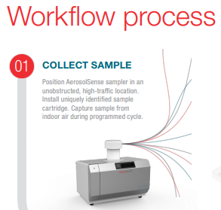
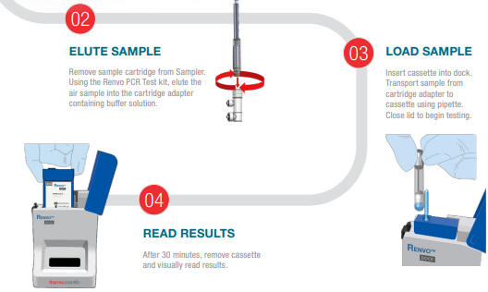
Different type of air sampling available
Thermofisher
AerosolSense™ Sampler
Catalog number: AEROSOLSENSE

Slide 18

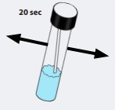
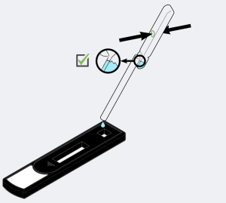
Biofilm Swab: Commercially Available kit
Hydrosense Ultra Legionella Swab Kit
Working Principle:
- Similar to an ART kit, after swabbing a minimum area of 10cm2, the swab is inserted into a recovery buffer vial.
- An exact volume pipette is used to release 0.1ml of sample onto the test strip .
- After 25 minutes (and before 30 minutes) read your Hydrosense Legionella test.
- The test is composed of two lines; a test line (TL) and a control line (CL). If both lines are present, even if the test line is very faint, then Legionella pneumophila serogroup 1 has been detected above the cut-off of the test kit (>200 CFU/ per swabbed area)
Notes:
https://cdn2.hubspot.net/hubfs/3881041/Instruction%20Leaflets%20/Swab%20Test%20Instructions.pdf

